Slide 1

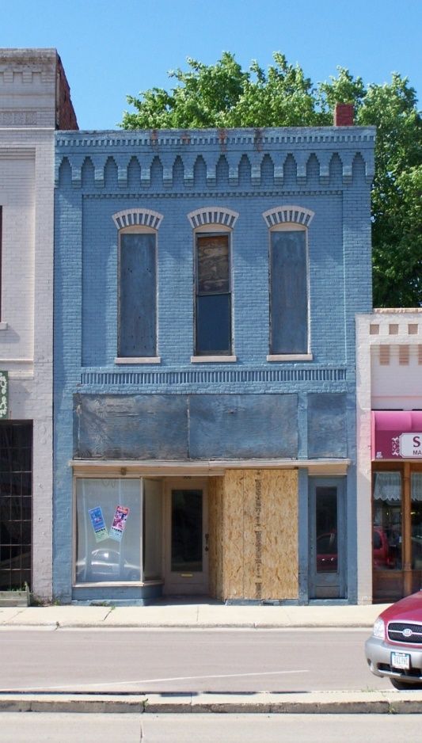
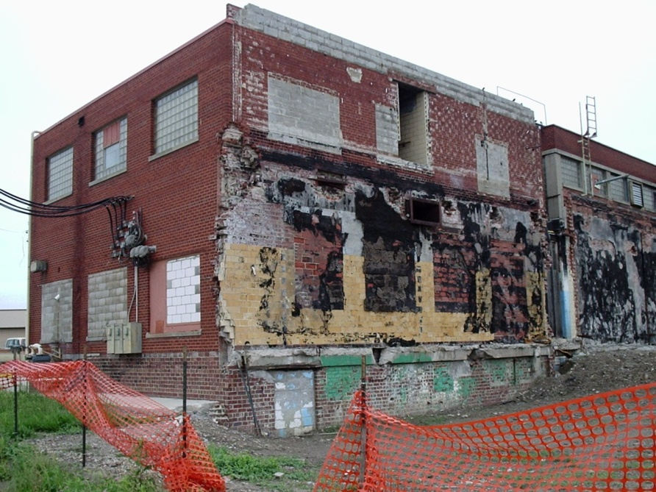
Facilities and Projects: Dealing with Dangerous and Dilapidated Buildings
Jim Thompson – IEDA
Mel Pins – IDNR
Jennifer Davies – City of Slater
Justin Myers – Myers Construction, Mediapolis

Slide 2

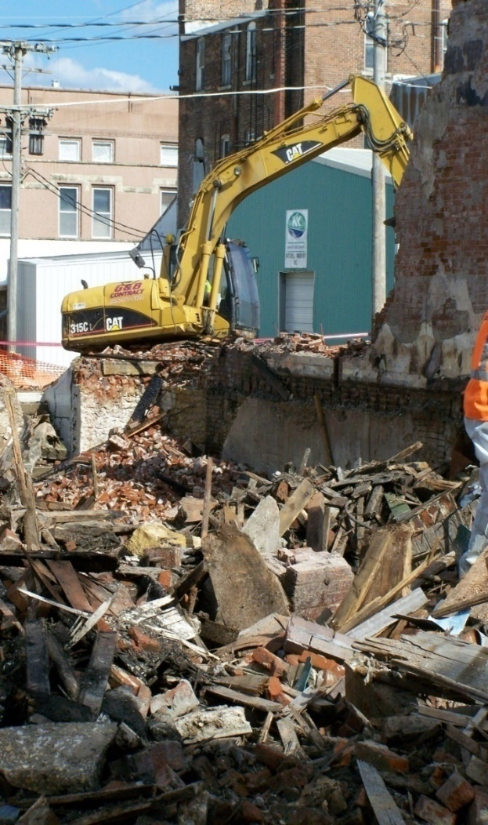
Issues, Approaches, Assistance and Success
Issues with Old Buildings:
Detracts from community character, stability, and investment
Can be a public hazard with trespass or collapse
The longer they sit, the more costly to someone to address
Environmental hazards and regulations for proper demolition
Approaches:
Do you press owner for compliance, or do you take control of the building?
Assistance:
What can help current owner for funding? What can help a community or others if they want to ‘foster parent’ or ‘adopt’ the building for a new start
Success:
- Programs, partnerships, and examples of what works!

Slide 3
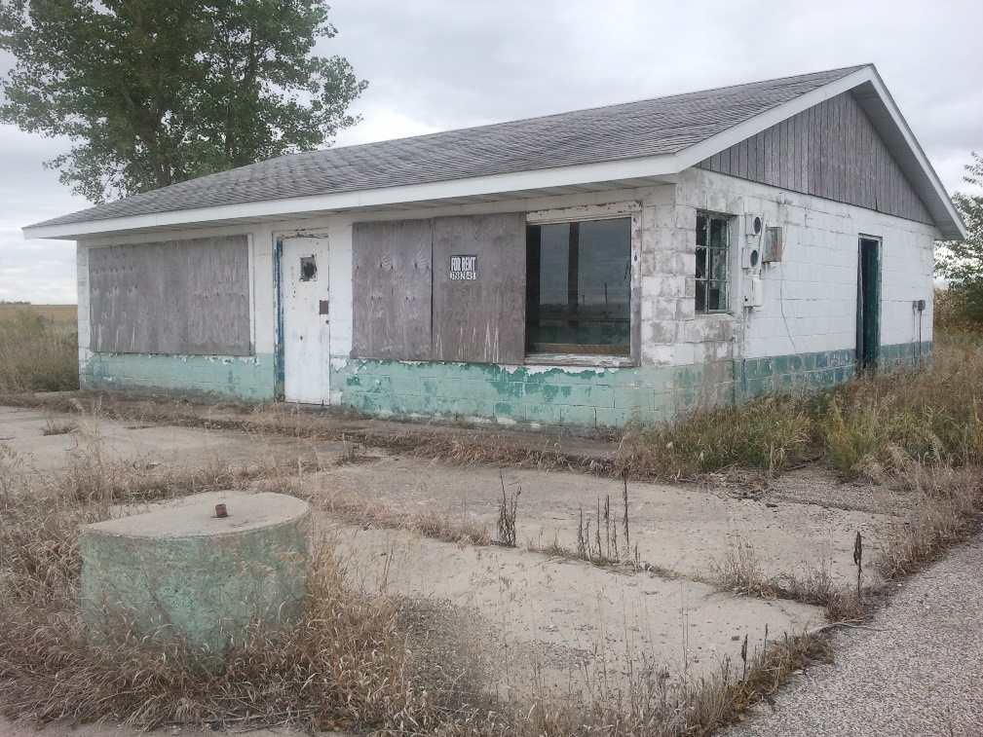
Approaches: Stick or Carrot?
Use your Building Maintenance Code or Nuisance Ordinance
If you Don’t Have One, Get One!
Might Seem Difficult, But Practice Makes Perfect
Sometimes City Control of the Property is Necessary to Facilitate Demo or Rehab
- Iowa Code 657(a) “Abandonment Clause”
- Back Tax Redemption / Title Assignment
- Condemnation / Eminent Domain / Donation
Talk to state program staff BEFORE taking title to lay out strategy, timing, and ensure eligibility

Slide 4

Parnterships for Success!
Think Beyond the Issue at Hand: Turn the Obstacles into an Opportunity!
Think of What Could Be for Renovation, Repurposing, or Redevelopment
Easier to Get Buy-in with Something of Value as a Goal
Funding May be Available, But You Must Also Invest
Getting the First $$$ in will Help you Find More!

Slide 5
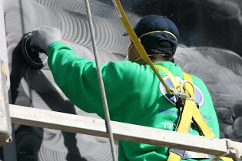
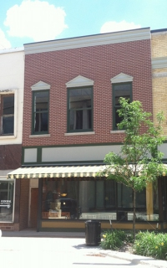
Assistance Programs / Grants / Tax Credits
Iowa Economic Development Authority
Community Catalyst Building Remediation Program
private/ public partnership – up to $100K
Redevelopment Tax Credit Program for Grayfields/Brownfields
private/ non-profit – up to $1,000,000
12% grayfield site redevelopment
24% brownfield site redevelopment
Iowa Department of Natural Resources
Brownfield Redevelopment Program
public / non-profit – grants and cost match up to $25,000
Environmental assessment and inspection (asbestos / lead-based paint / soil / groundwater)
Environmental cleanup or remediation of same
Derelict Building Grant Program
- local governments under 5,000 - up to $50,000
- demolition or renovation – demo requires 30% reuse and diversion of waste

Slide 6
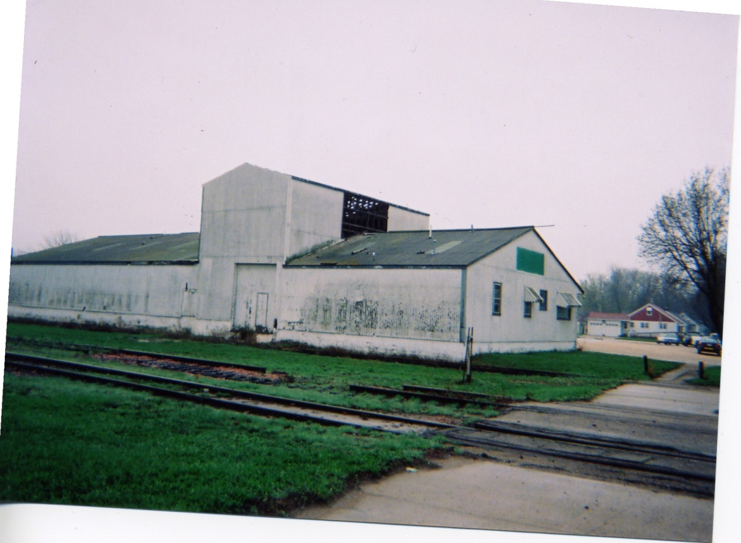
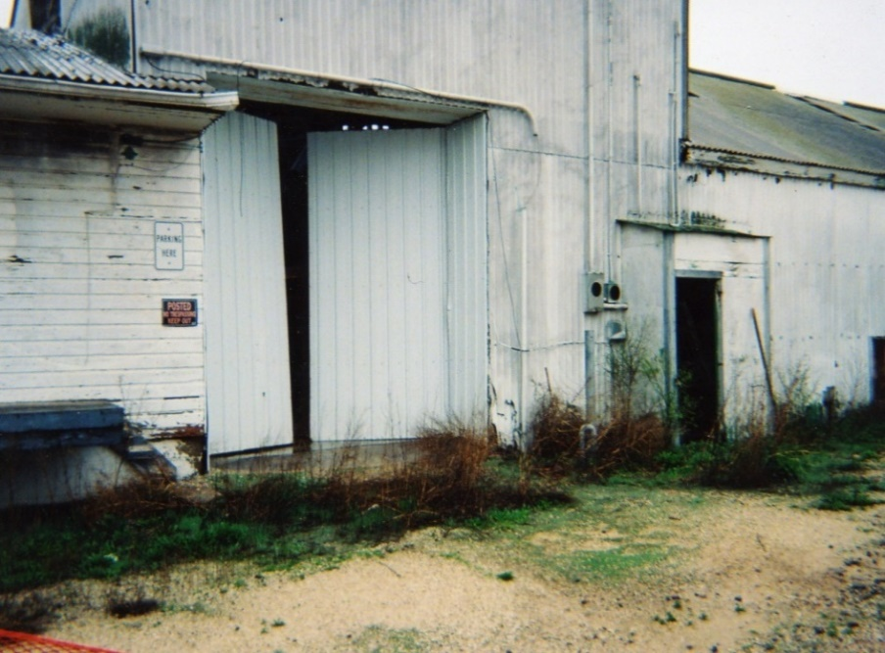
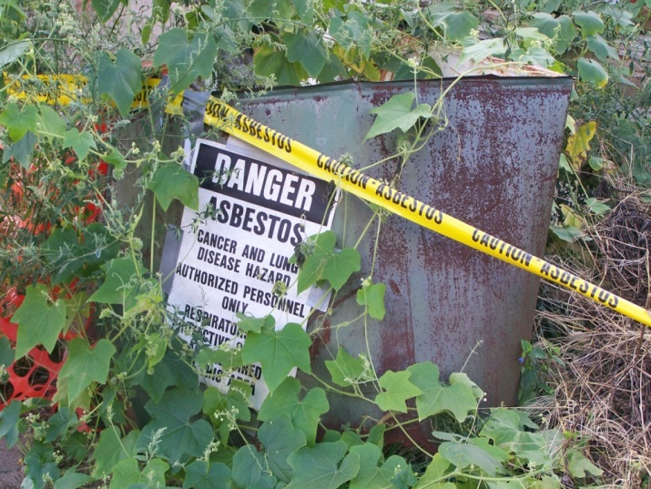
Emmetsburg –
Abandoned Warehouse

Slide 7
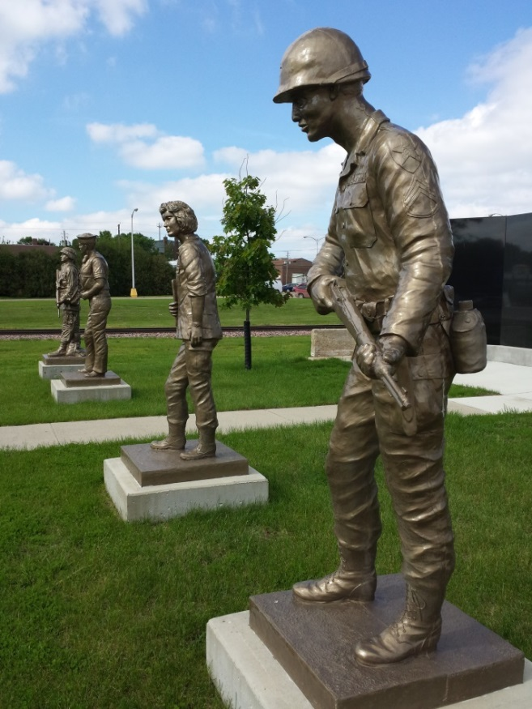
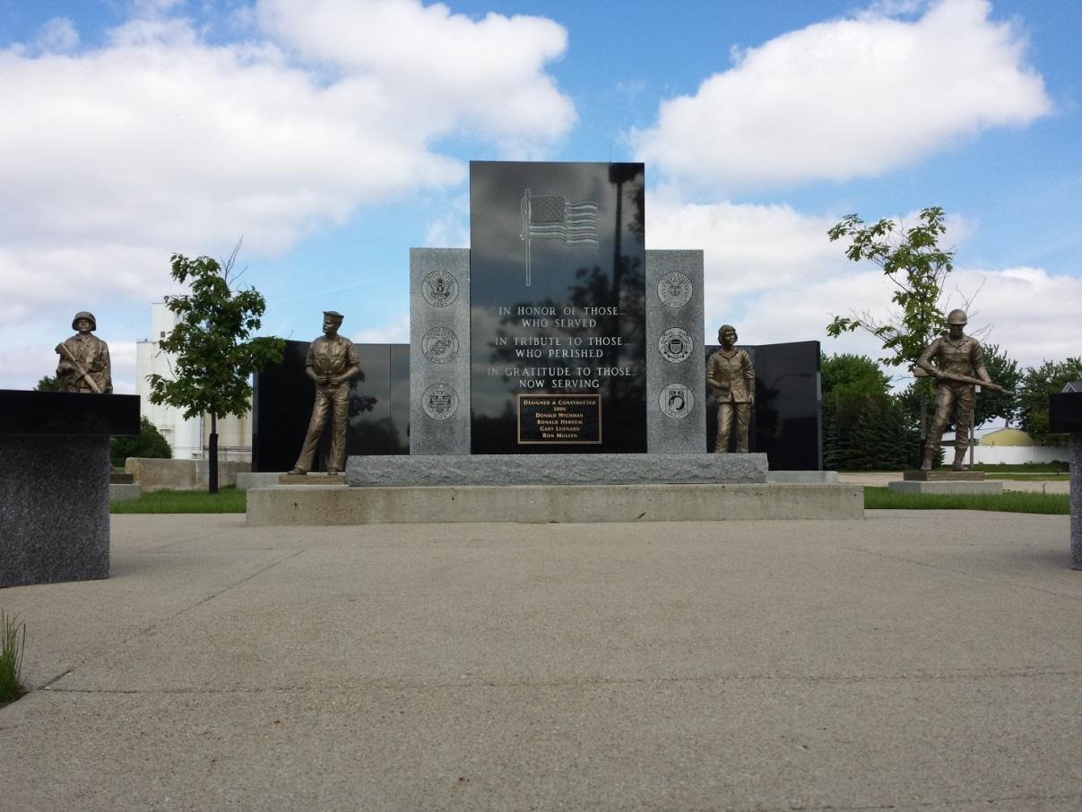
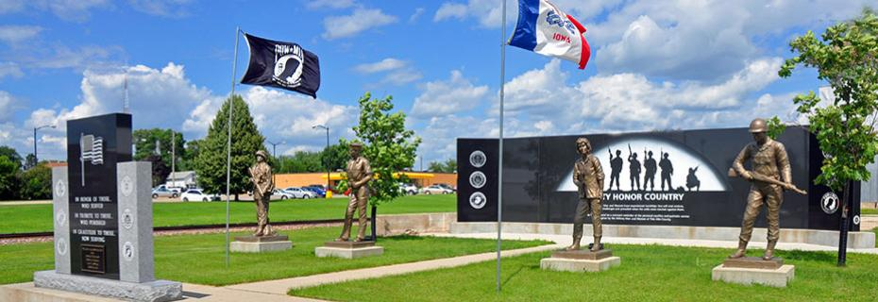
Emmetsburg –
Veterans’ Memorial Park

Slide 8
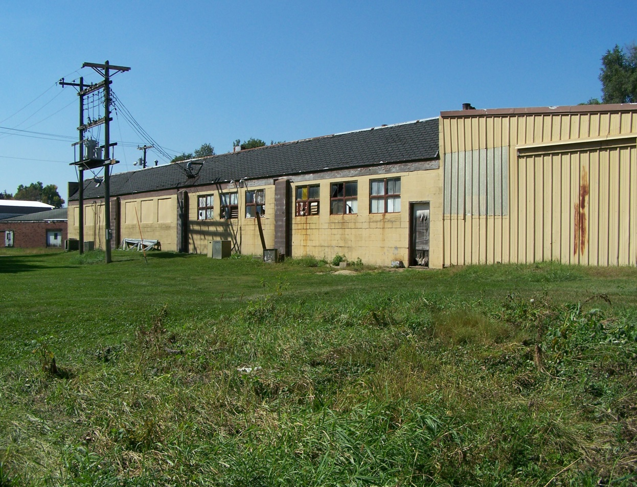
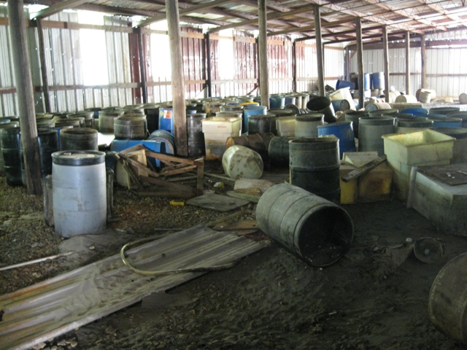
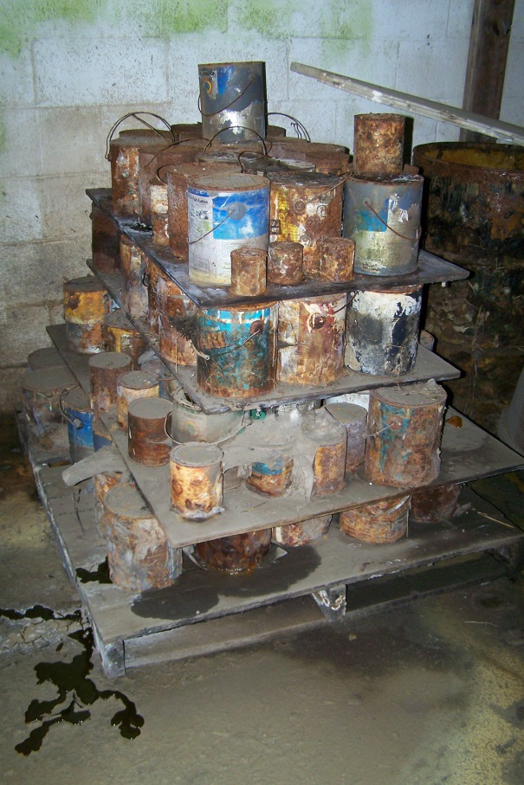
Monticello –
Abandoned Factory

Slide 9
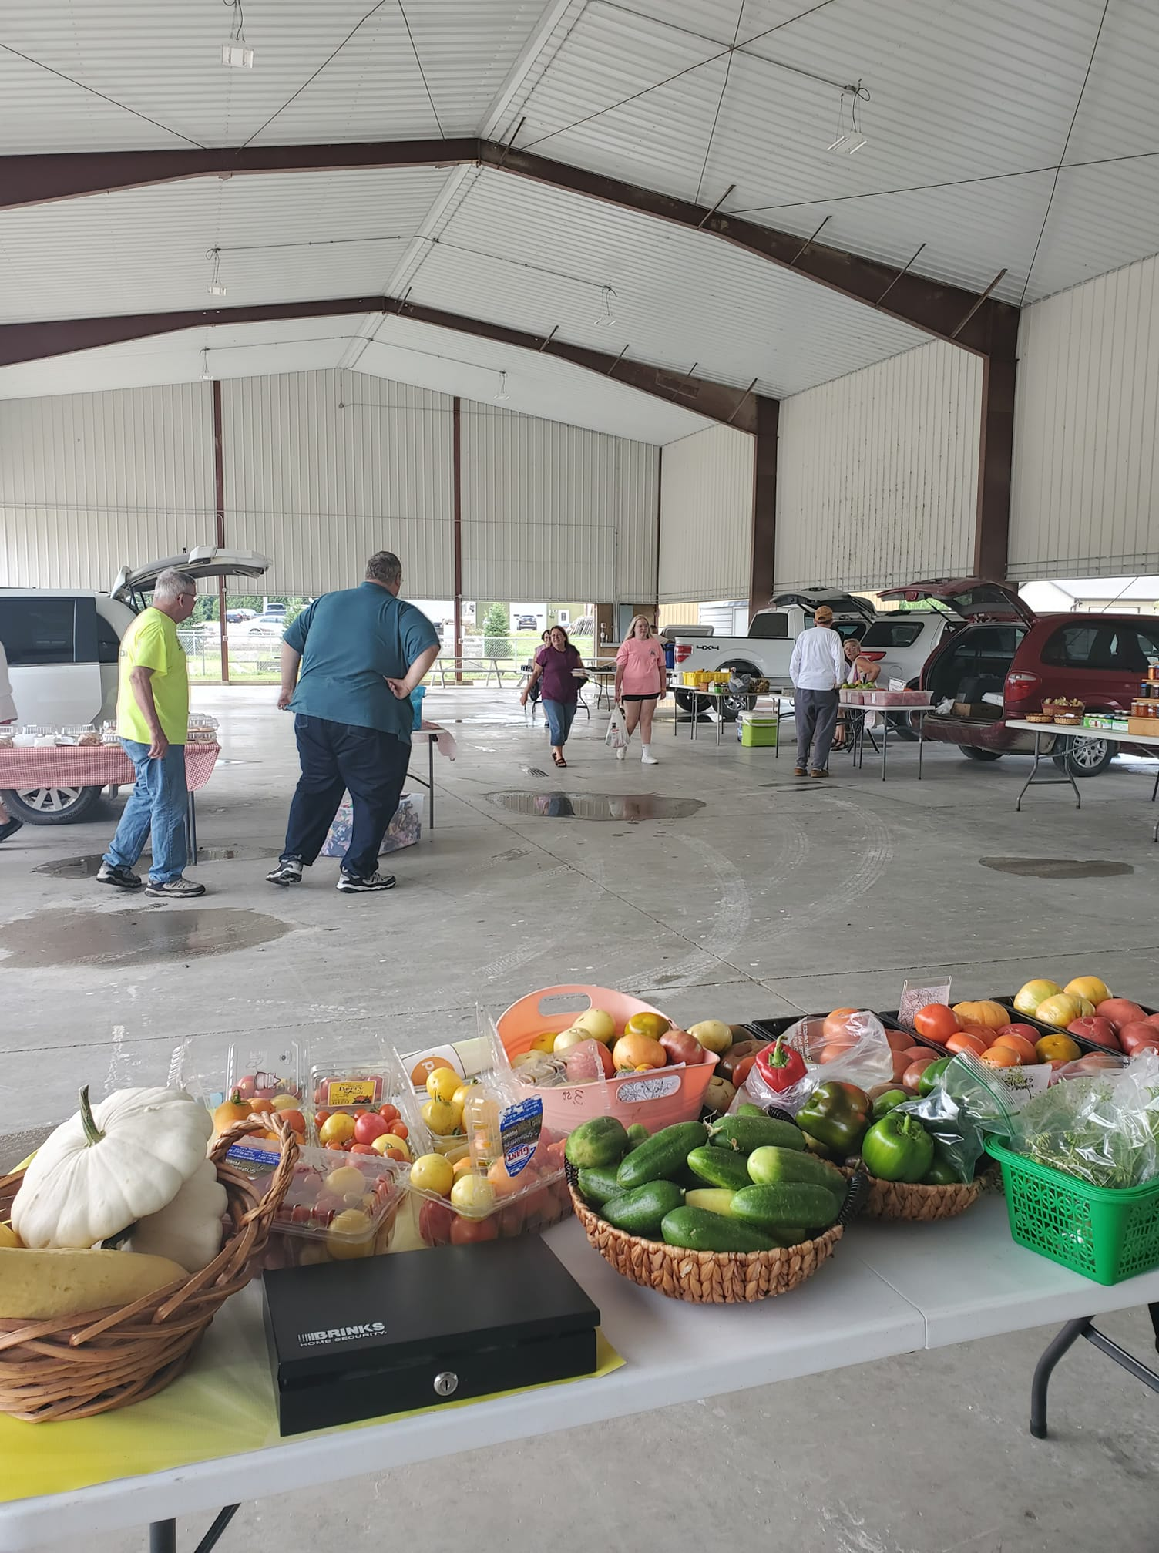
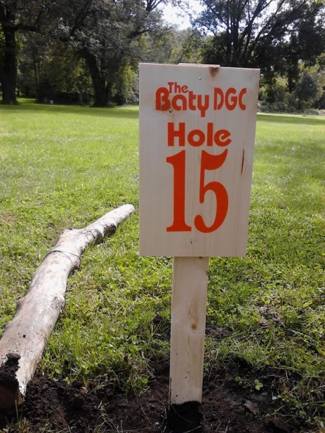
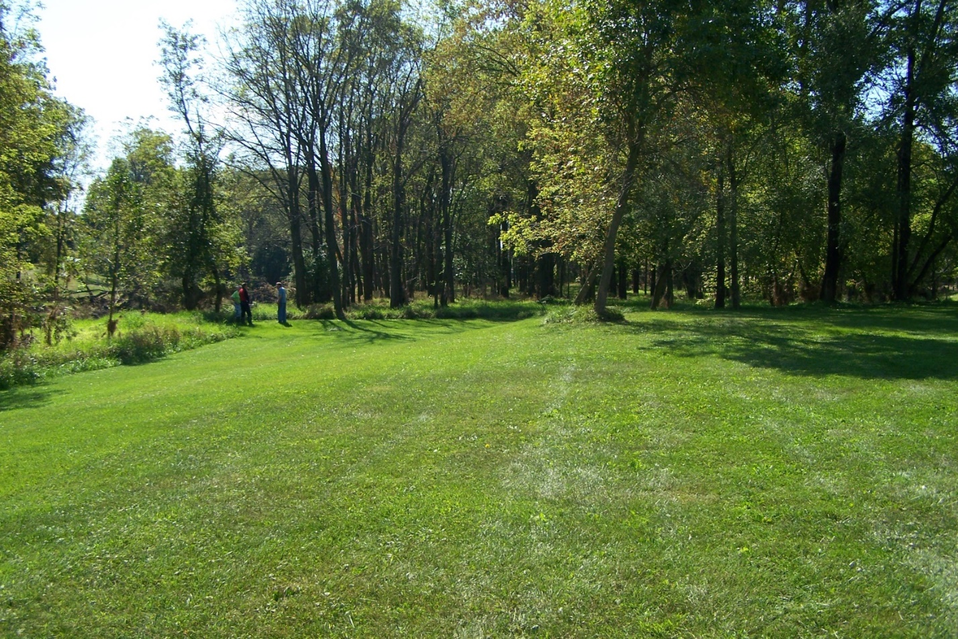
Monticello –
Greenbelt Park / Shelter / Disc Golf Course

Slide 10
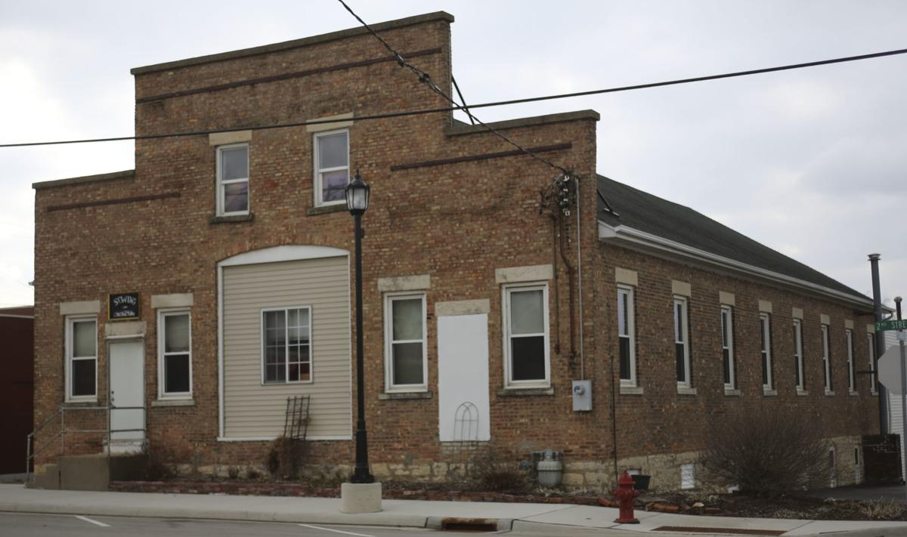
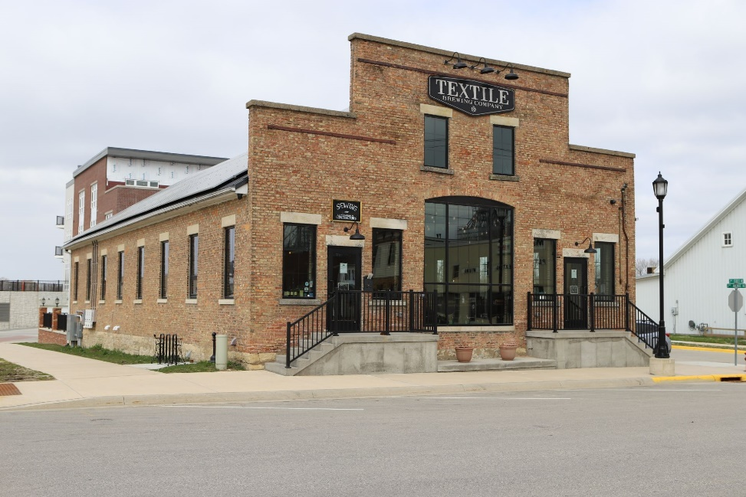
Contact Us!
Jim Thompson
Iowa Economic Development Authority
Jim.Thompson@iowaeda.com
515-348-6284
Mel Pins
Iowa Department of Natural Resources
Mel.Pins@dnr.iowa.gov
515-729-4616
Jennifer Davies
City of Slater
cityofslater@huxcomm.net
515-685-2531
Justin Myers
Myers Construction
Justin@myersconstructioninc.net
319-985-2170
Dyersville, Iowa -
Former gasoline engine and sewing factory becomes
“Textile Brewing Co.”
with program partners and funding for building renovation

