Slide 1
Leveraging Federal Dollars
“The Maquoketa Story”

Slide 2
Vision 2020
Two-year planning process completed in 2014
Downtown Revitalization top priority

Slide 3
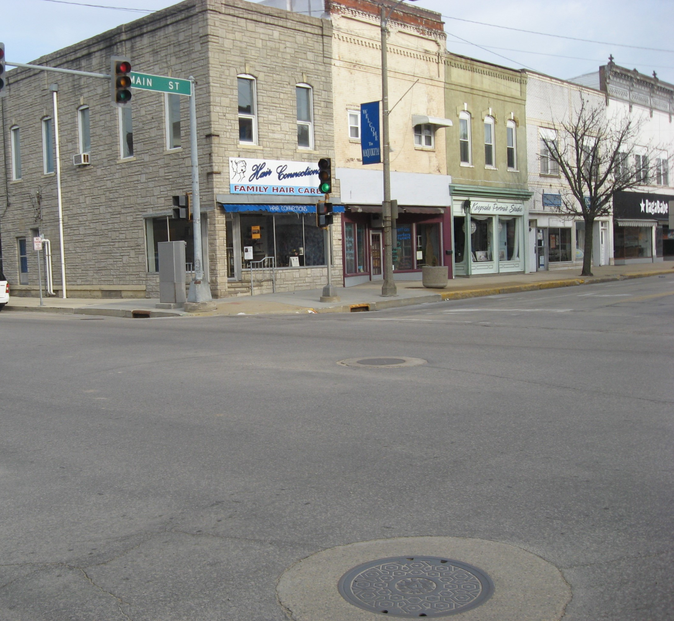
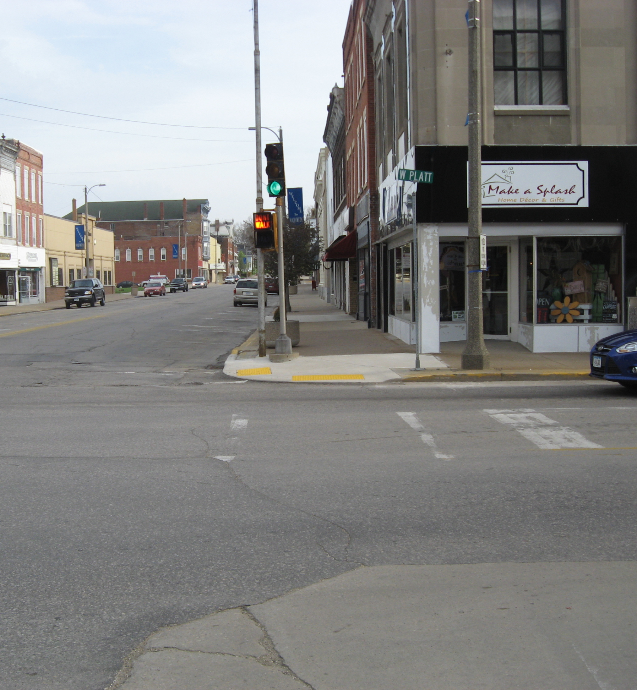
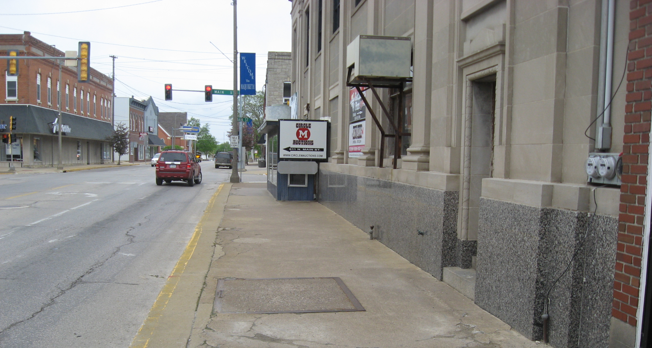
Before Downtown Revitalization

Slide 4
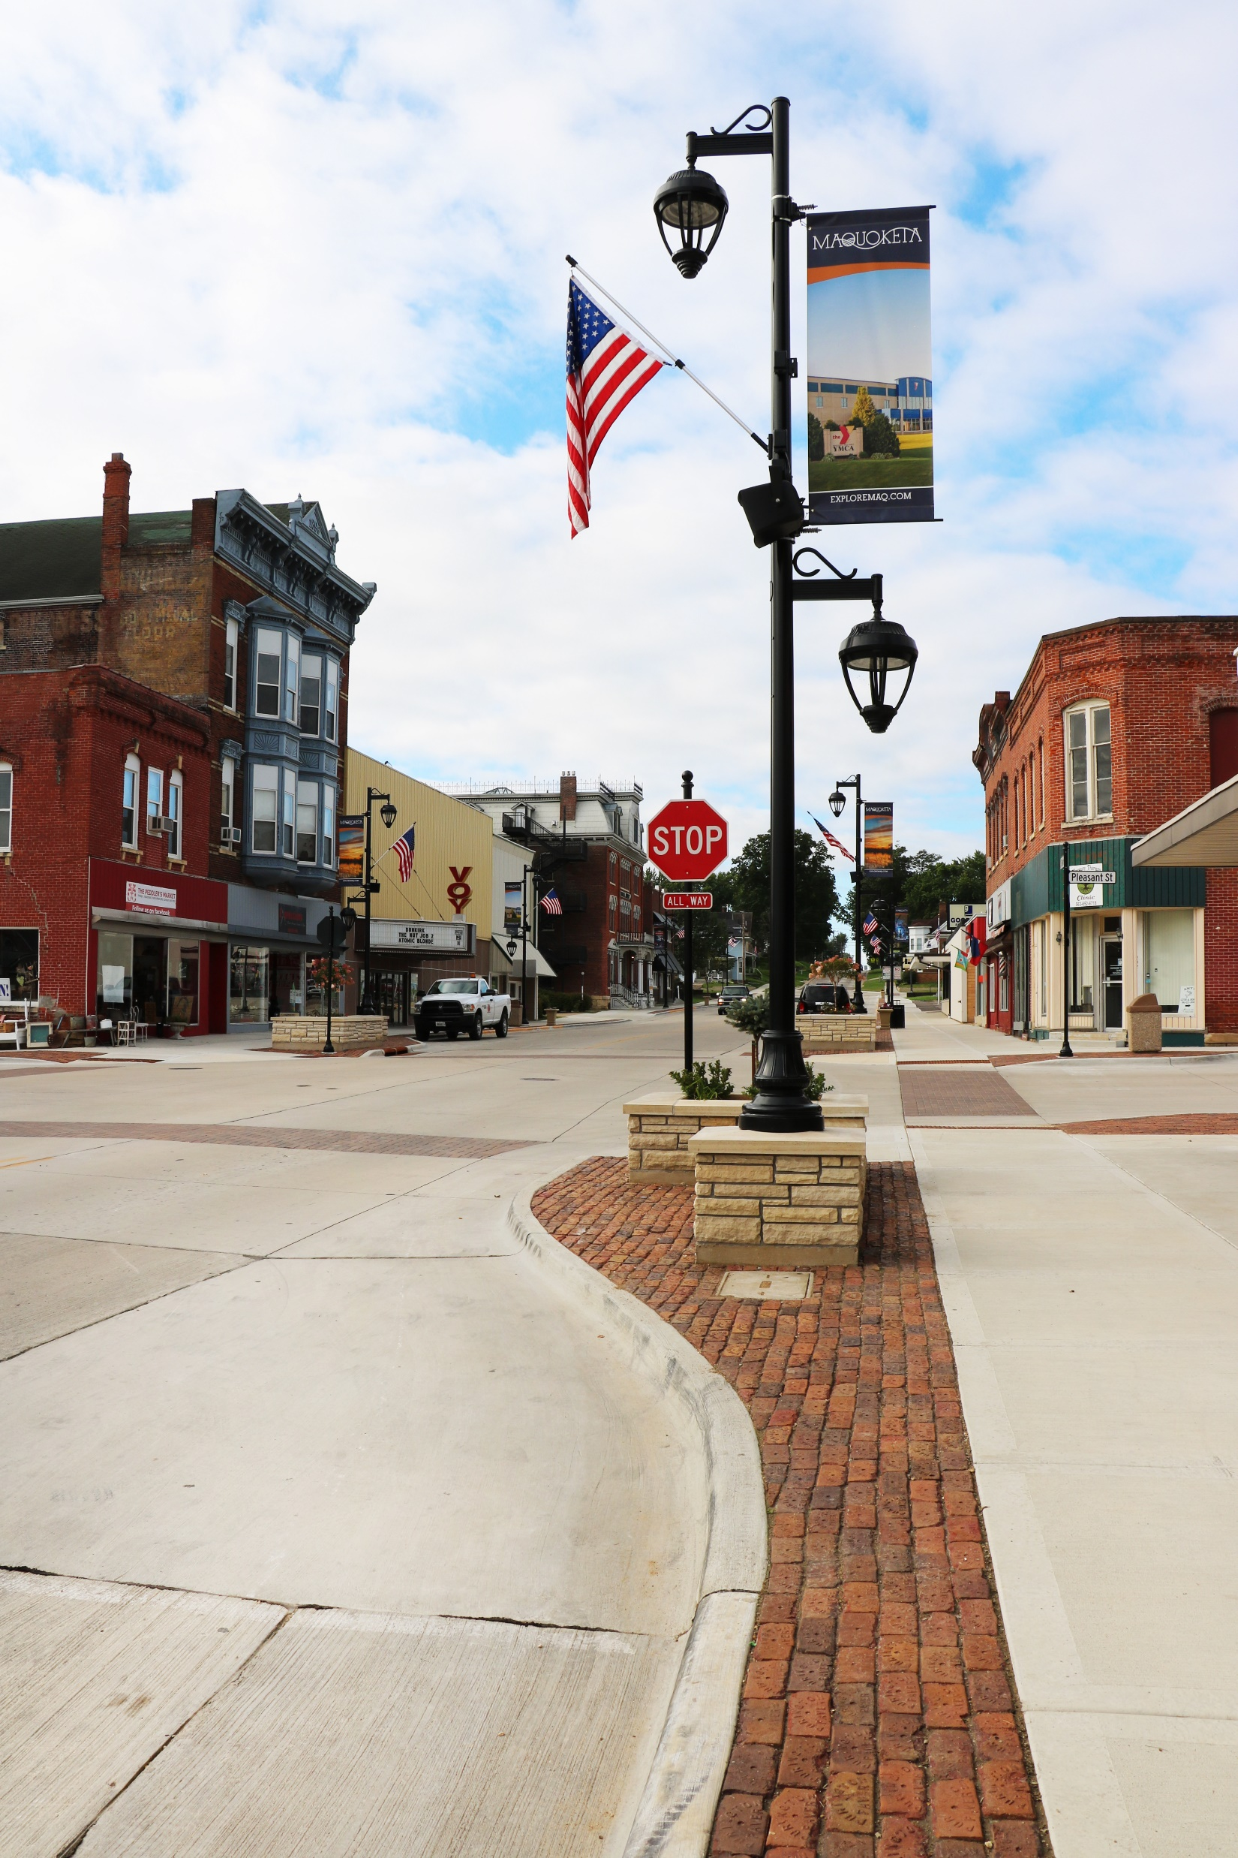
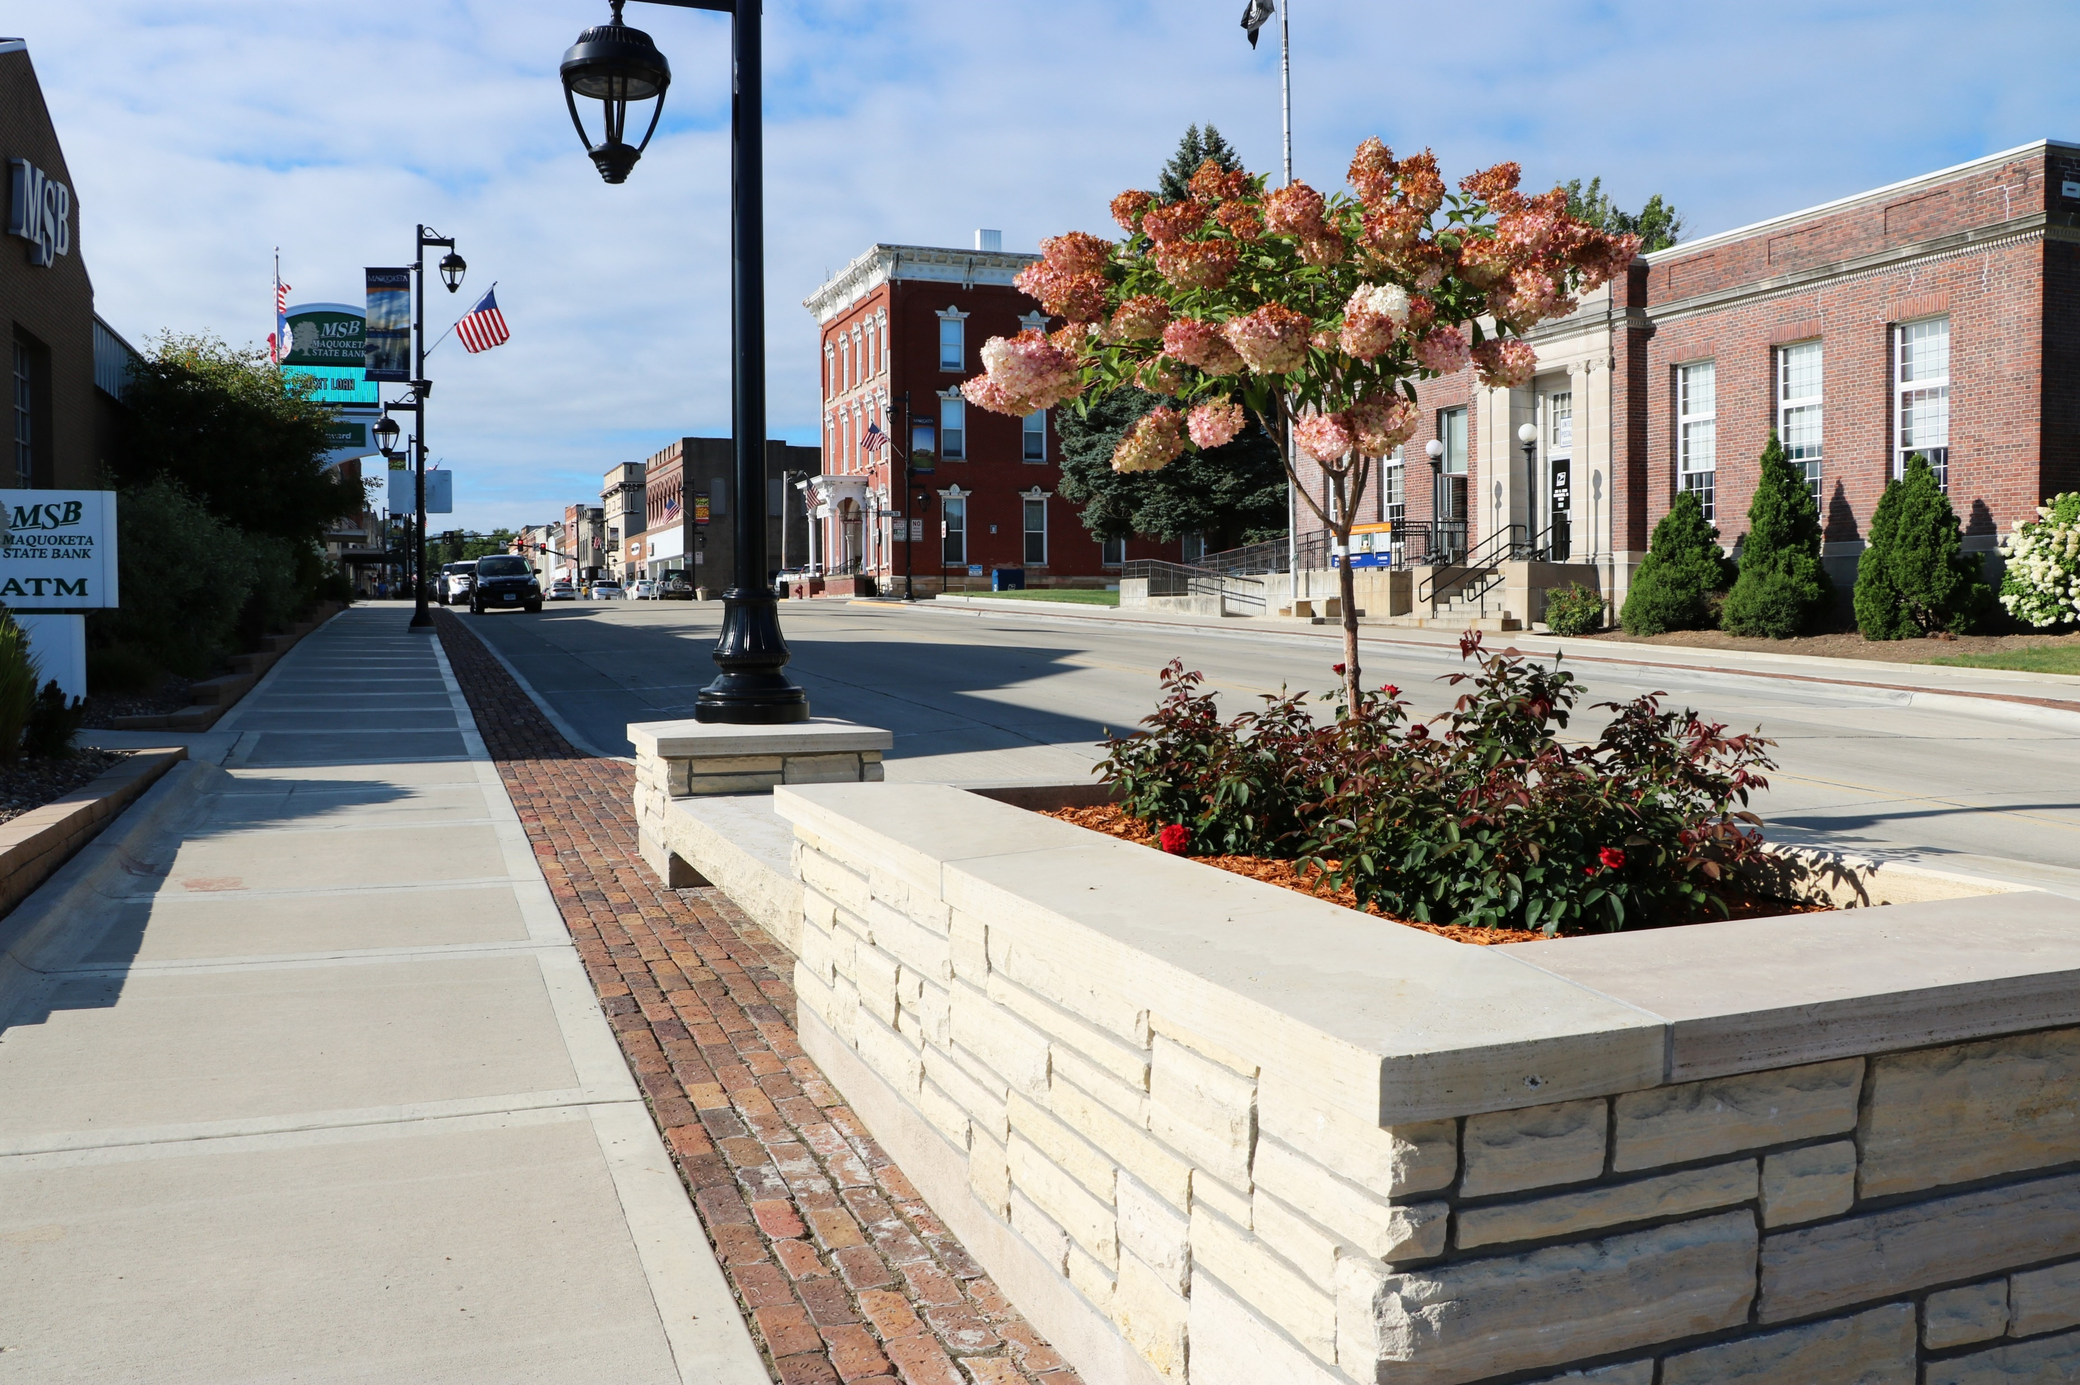
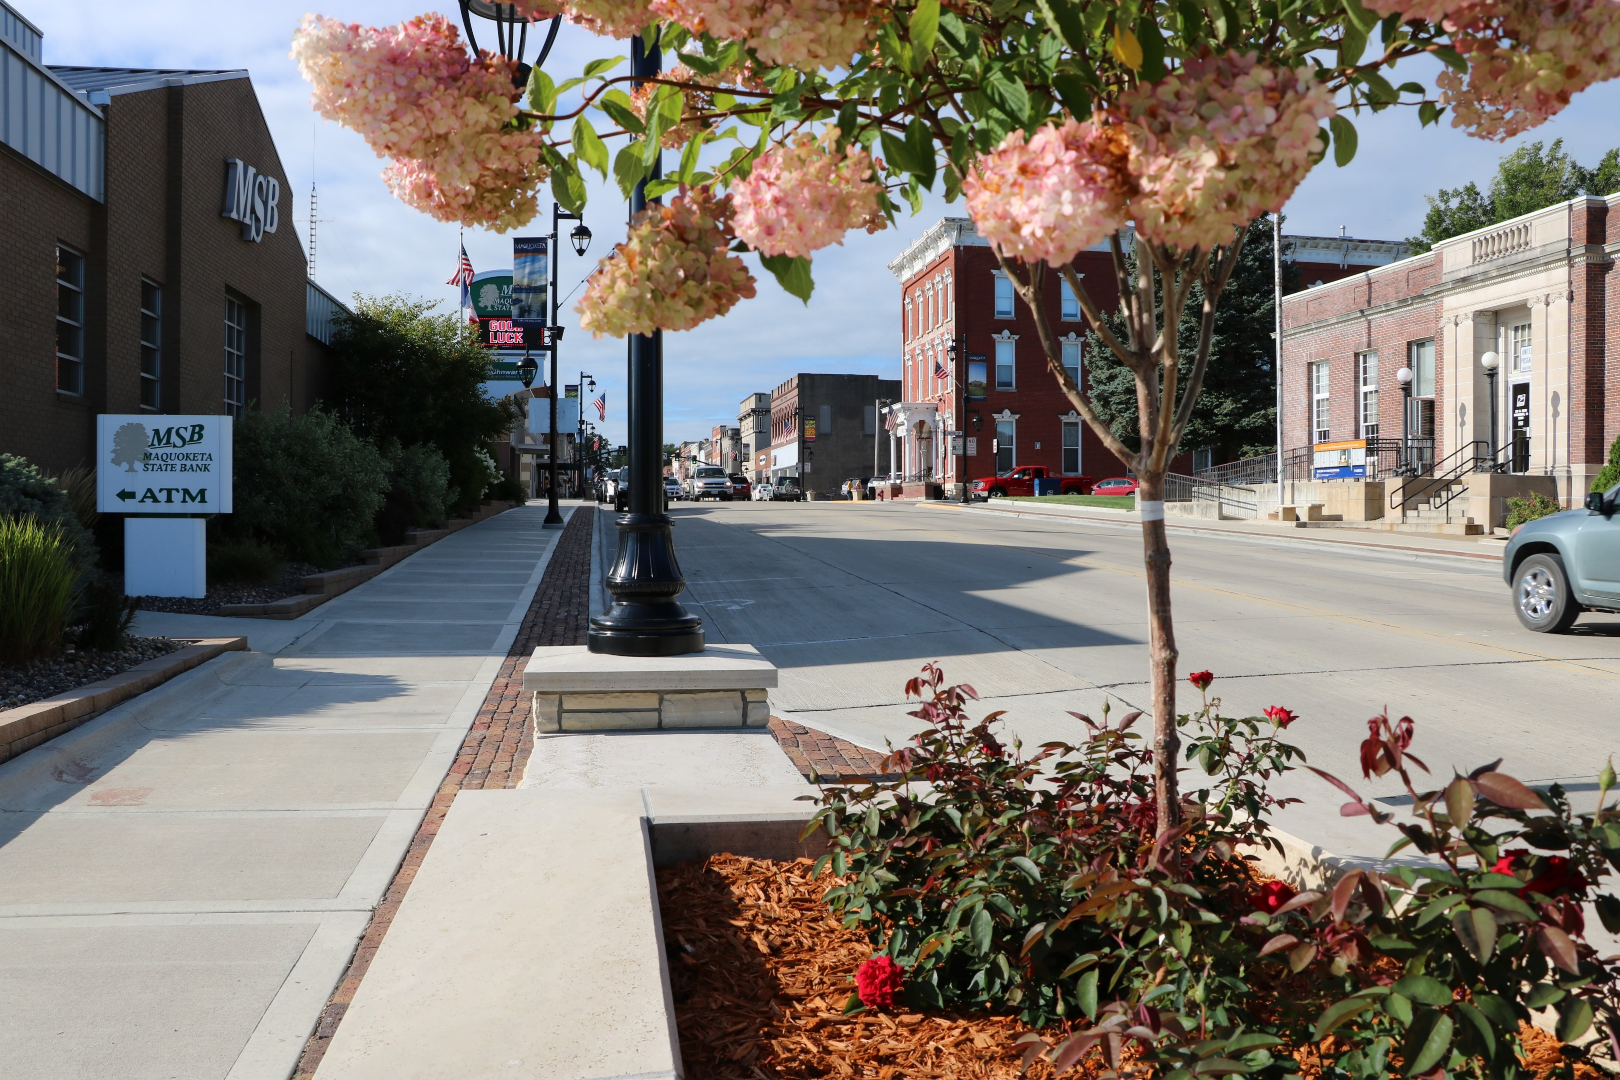
After Downtown Revitalization

Slide 5
Successful communities know how to work together and to bring partners to the table.

Slide 6
Leverage City Investment:
Established local incentive program
State grants
Federal grants
Tax Credits (Federal & State)

Slide 7
CDBG Façade Program:
Federal funds administered by IEDA
$500,000 grant with equal local match
$250,000 city
$250,000 property owners

Slide 8
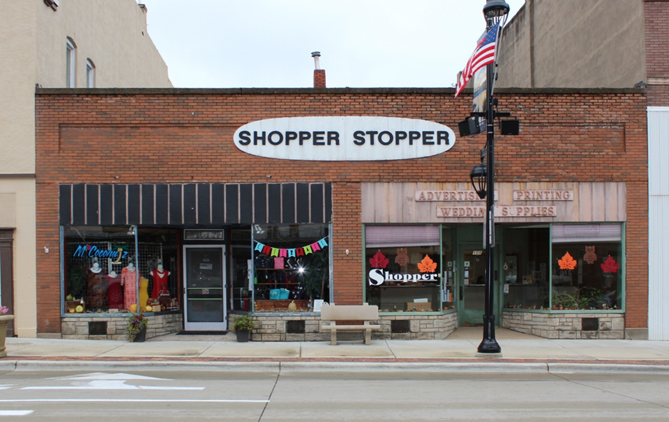
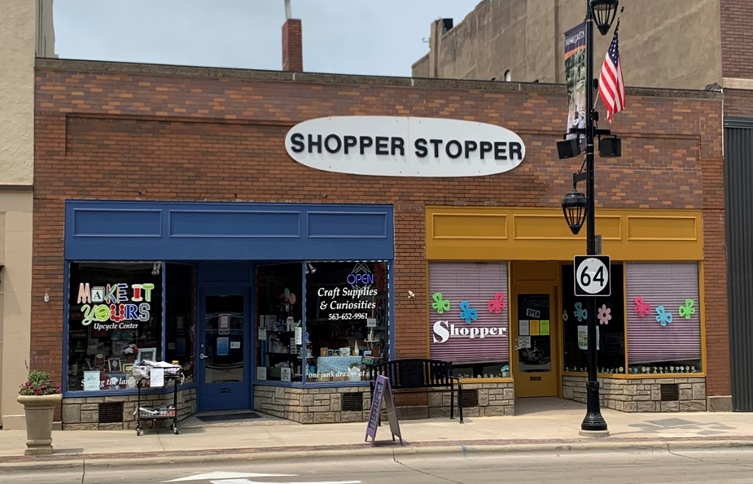

Slide 9
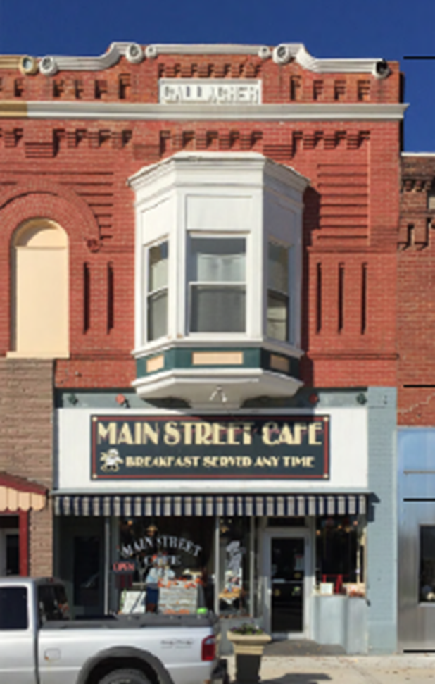
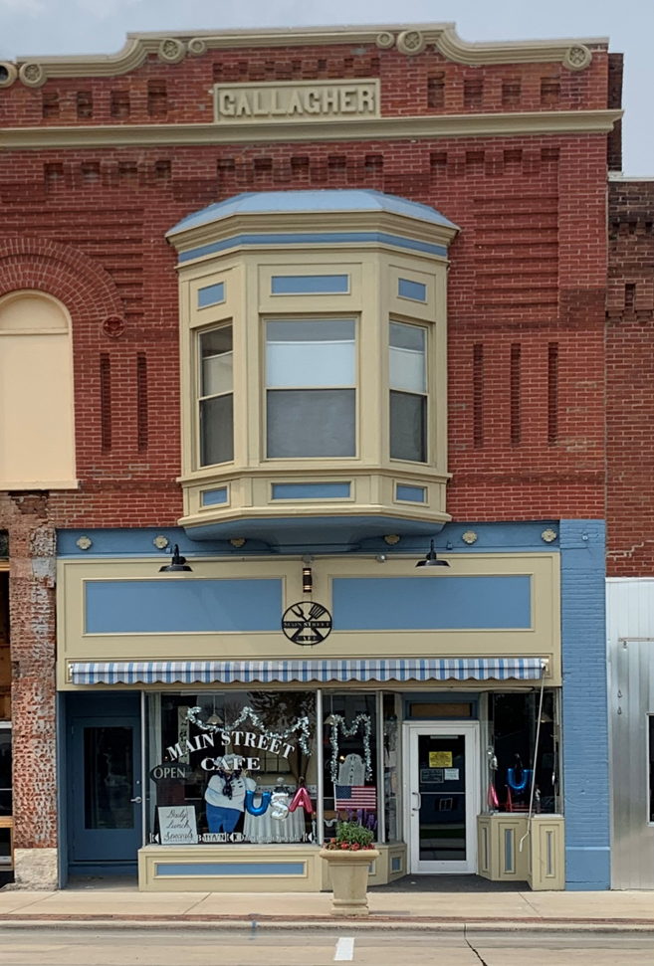

Slide 10
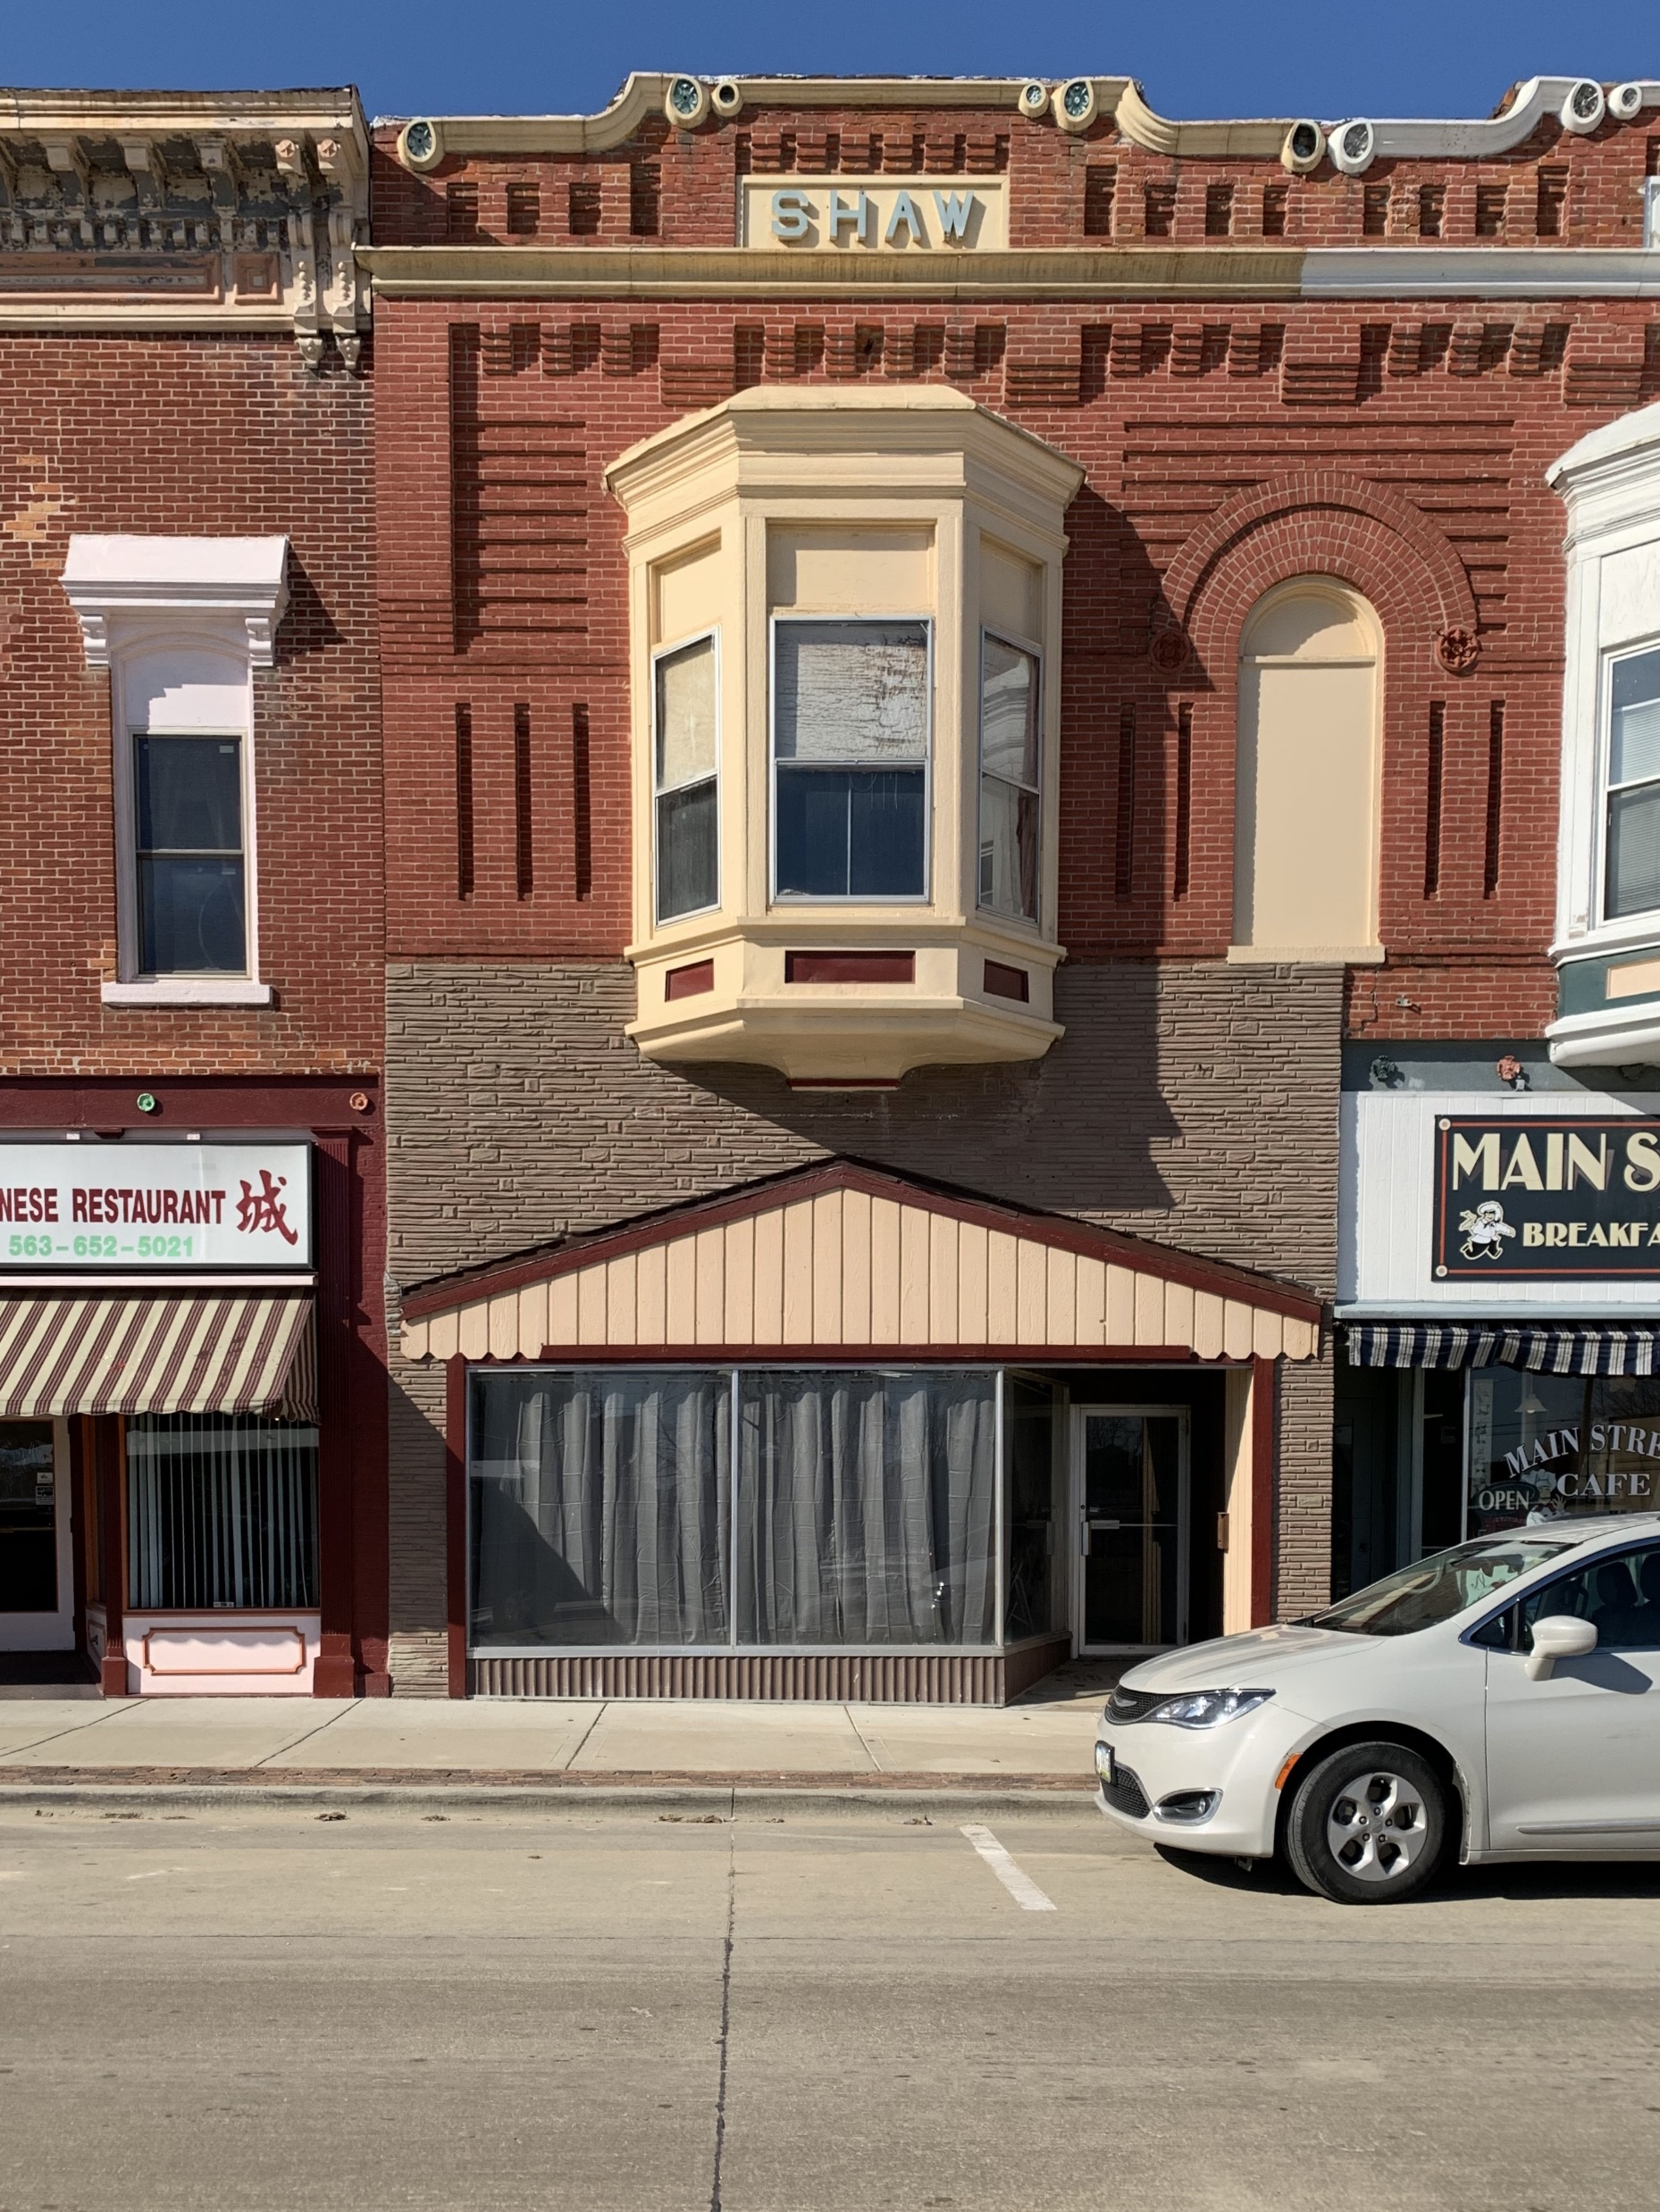
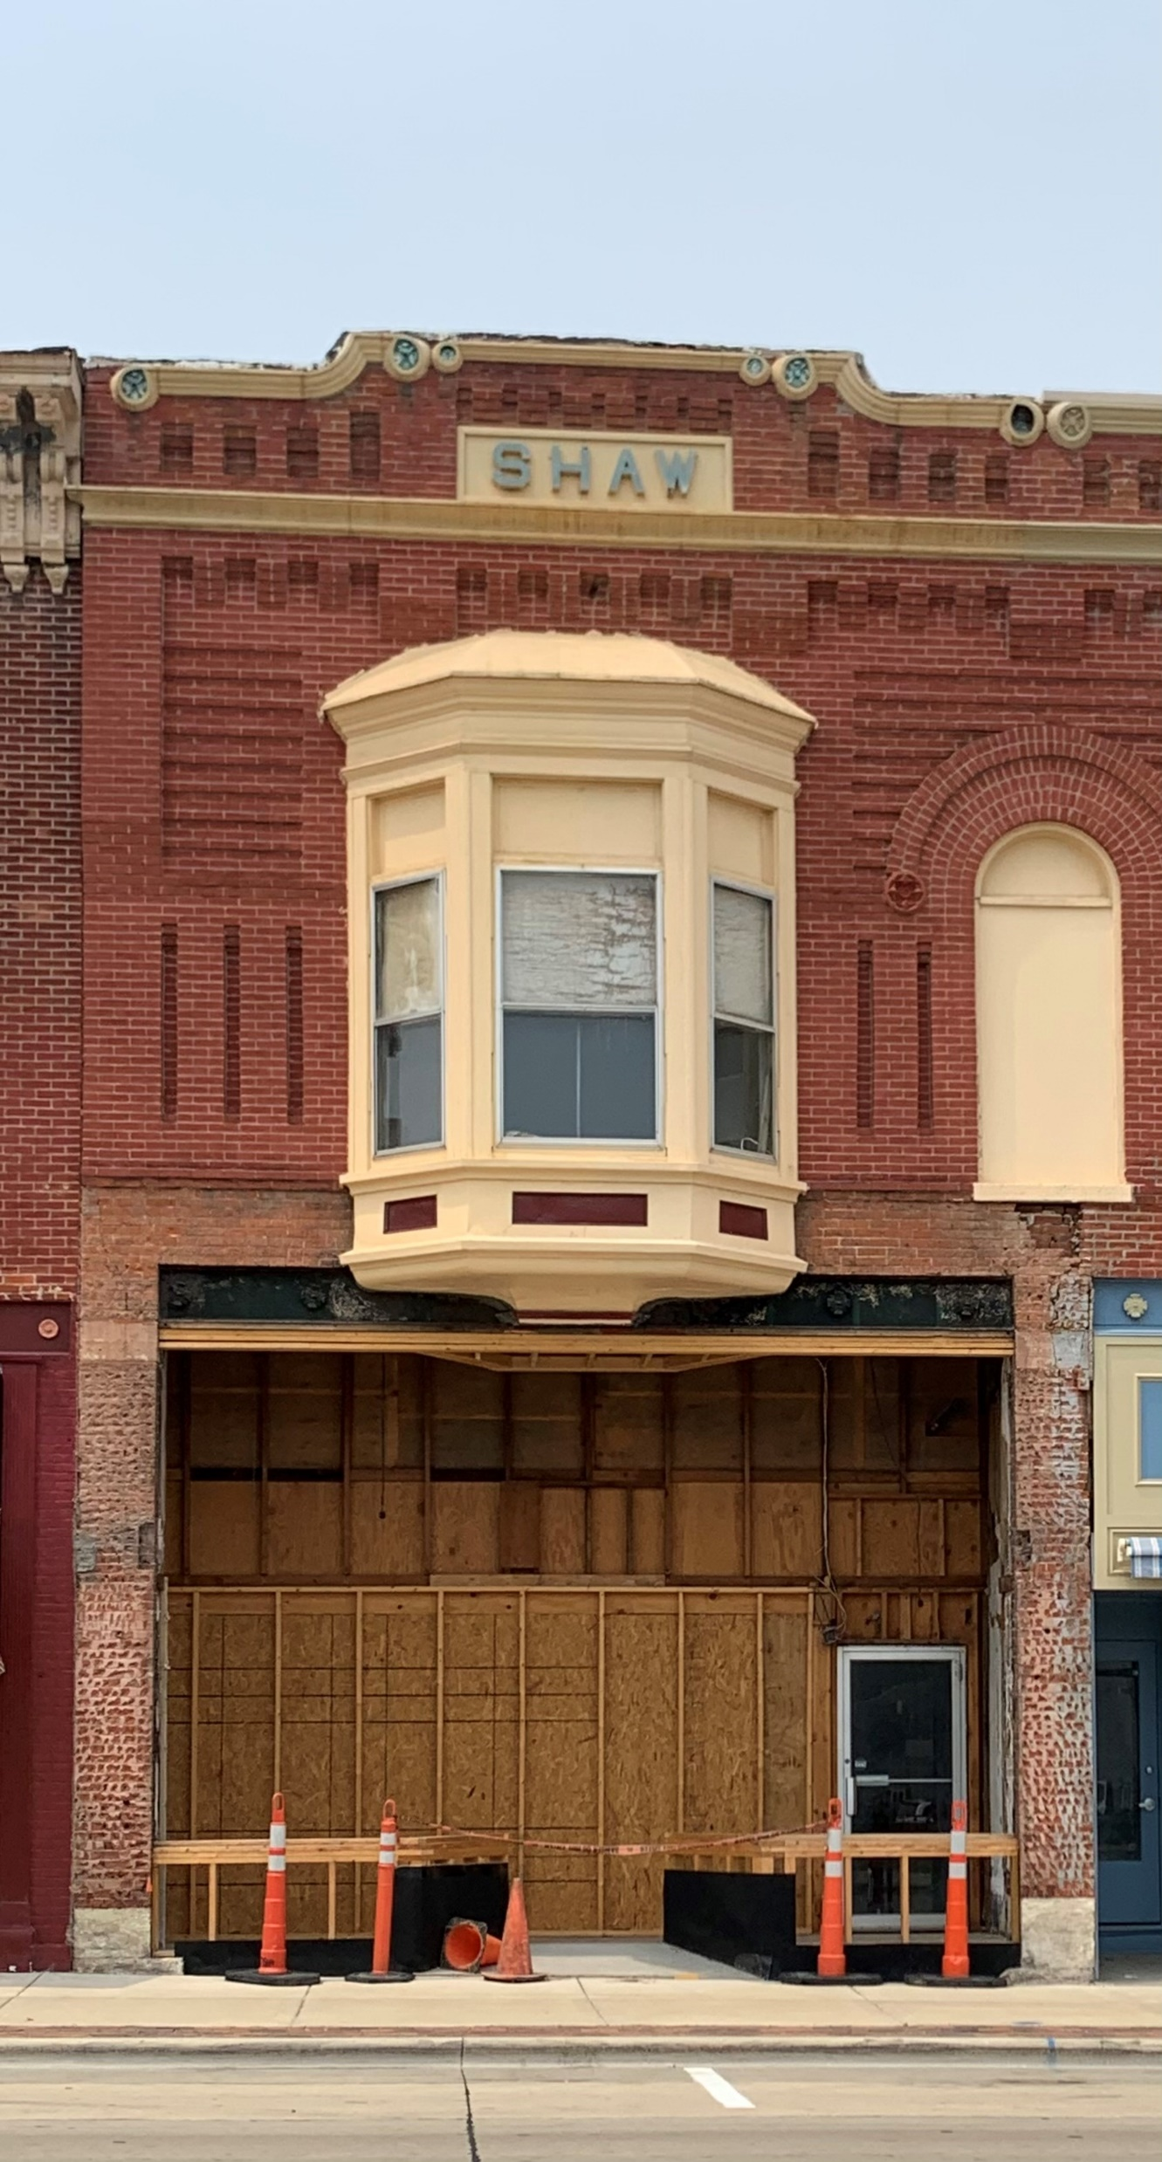
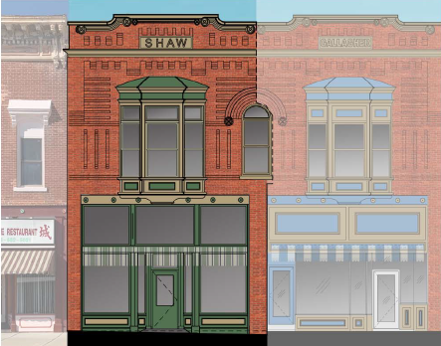

Slide 11
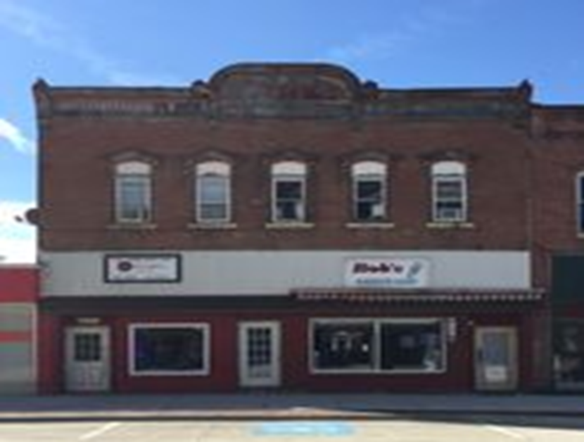
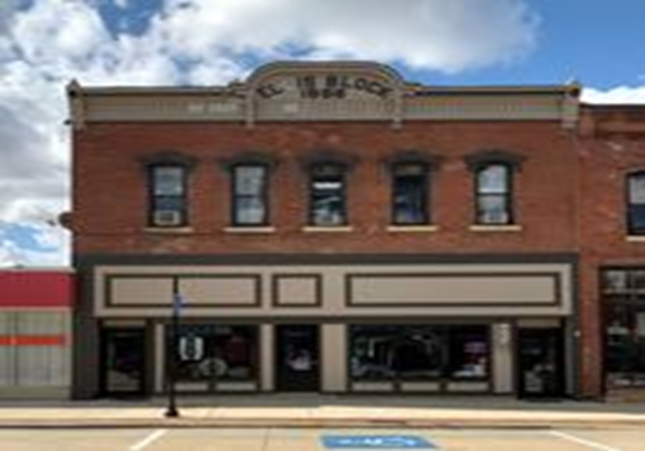

Slide 12
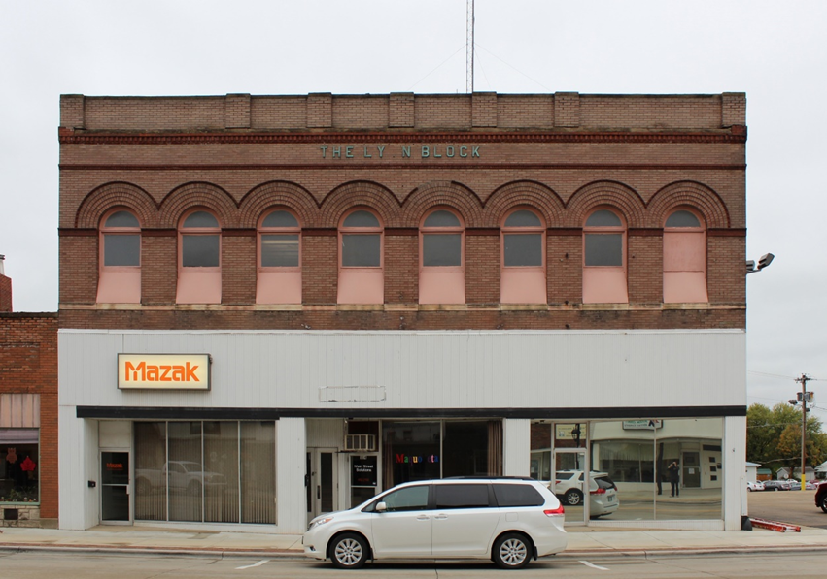
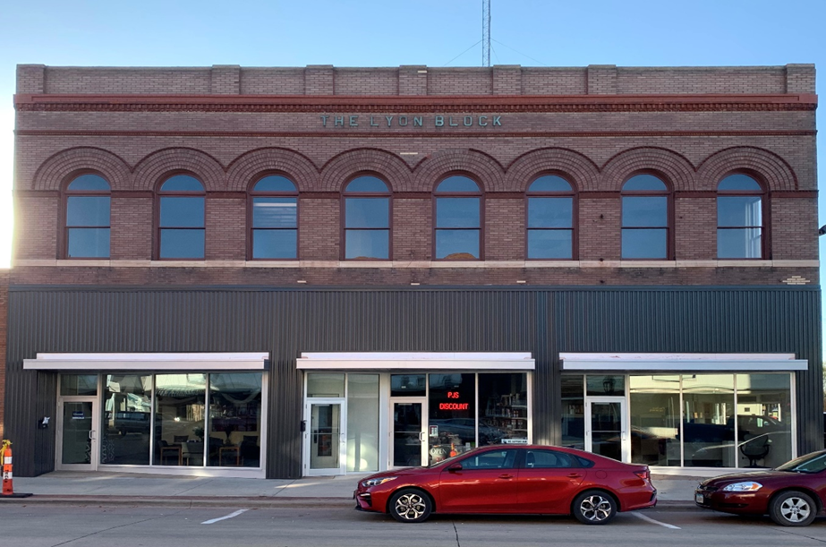

Slide 13
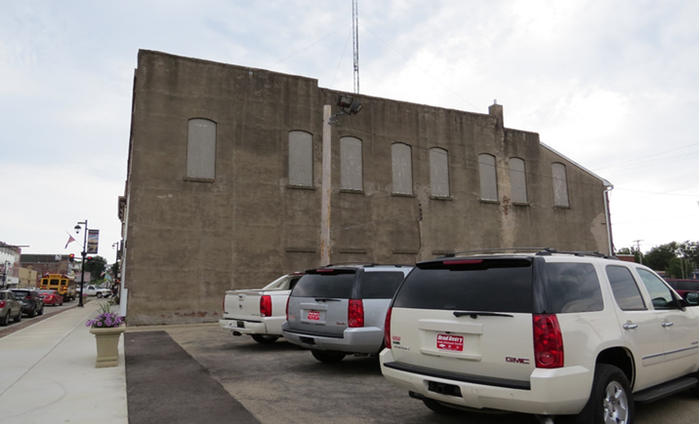
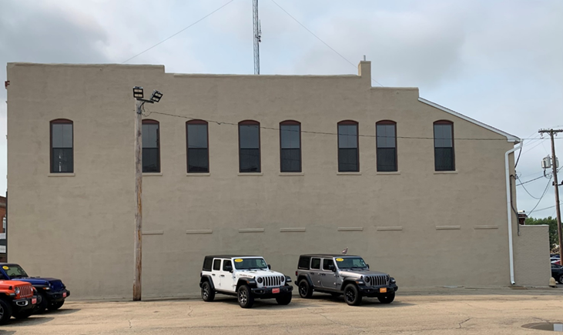

Slide 14
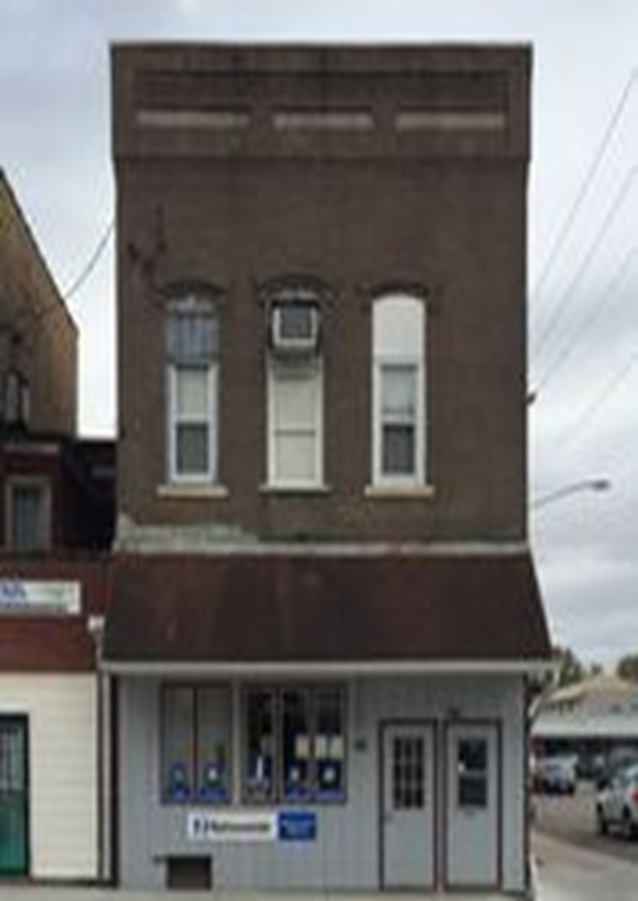
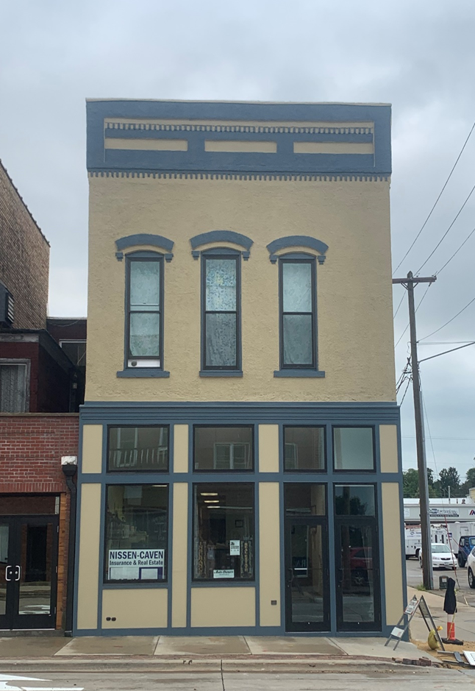

Slide 15
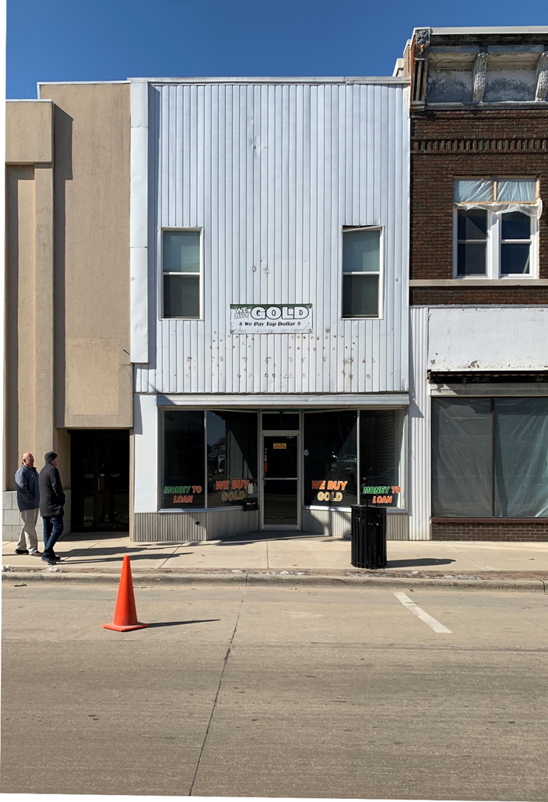
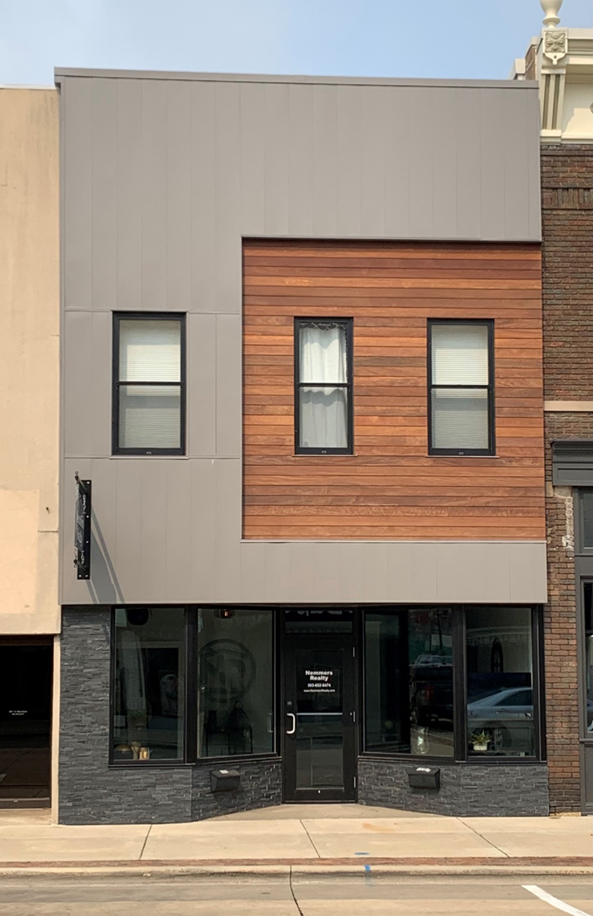

Slide 16
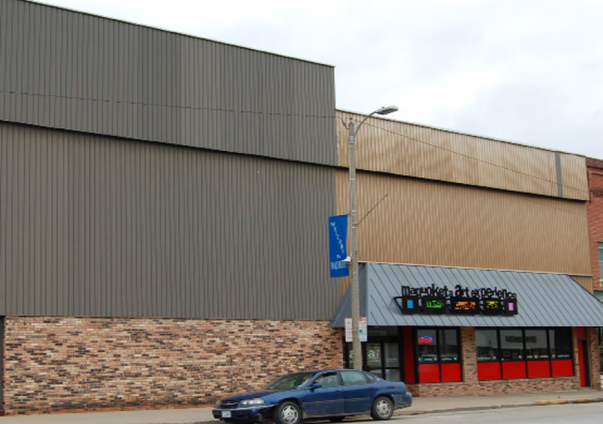
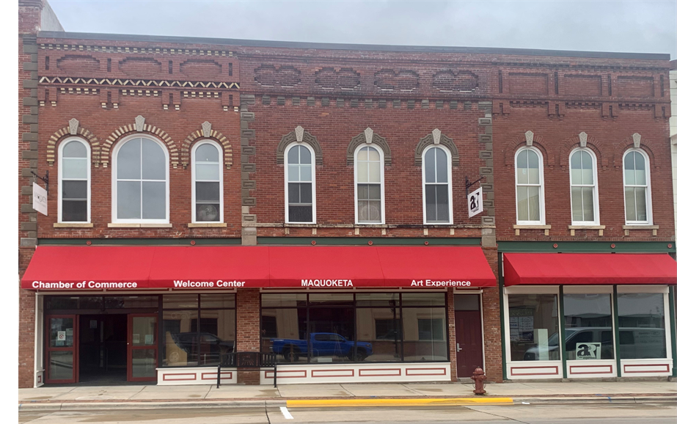

Slide 17
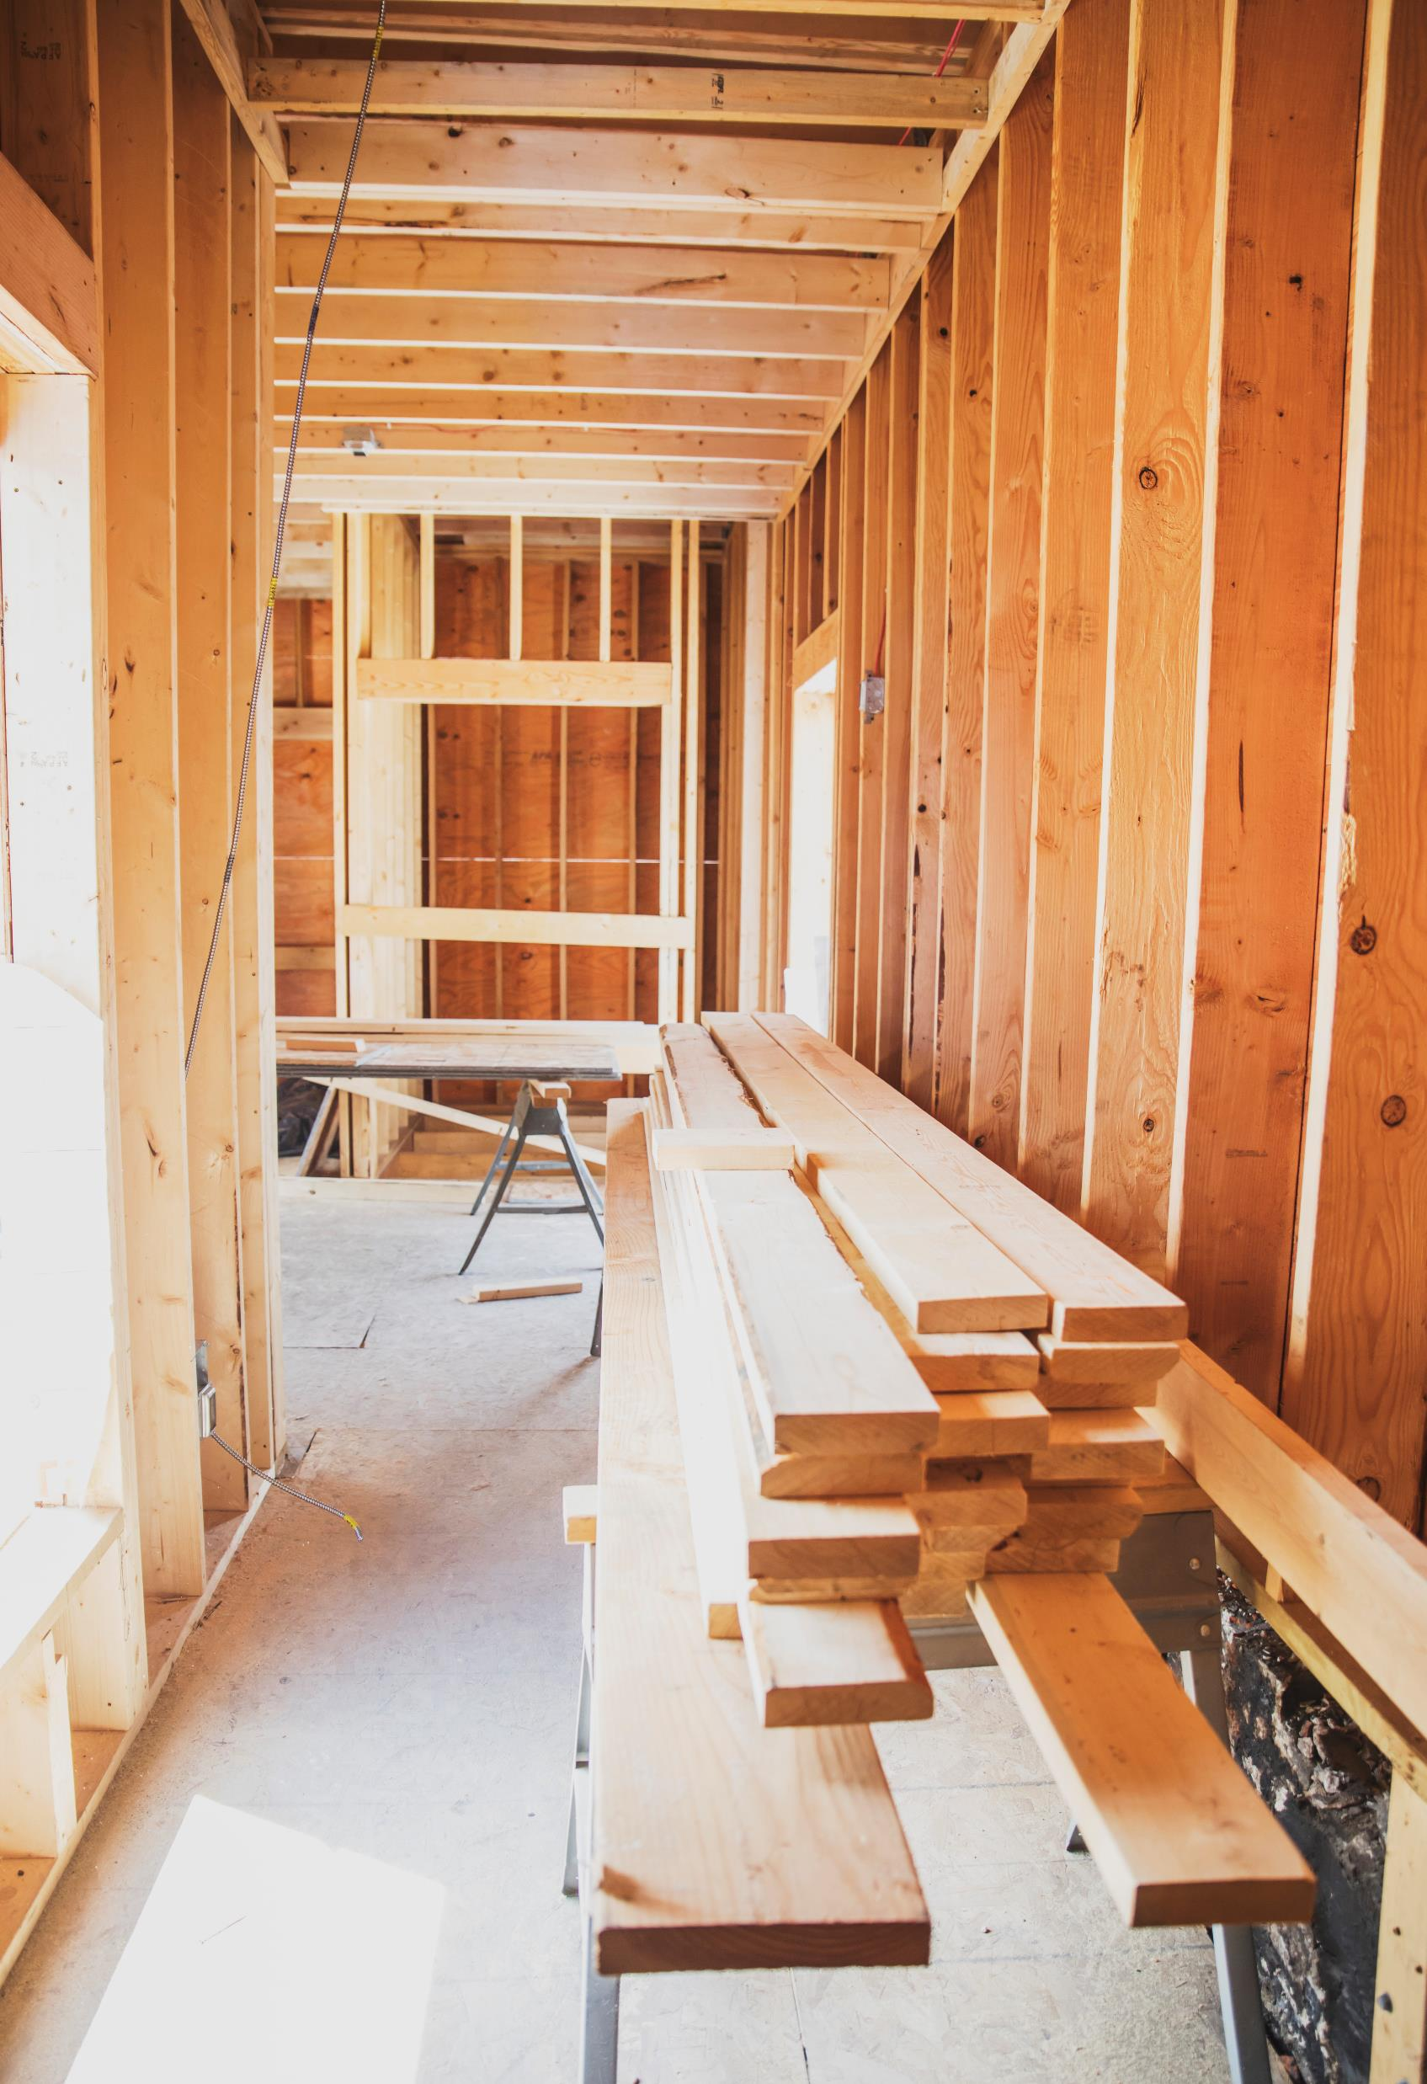
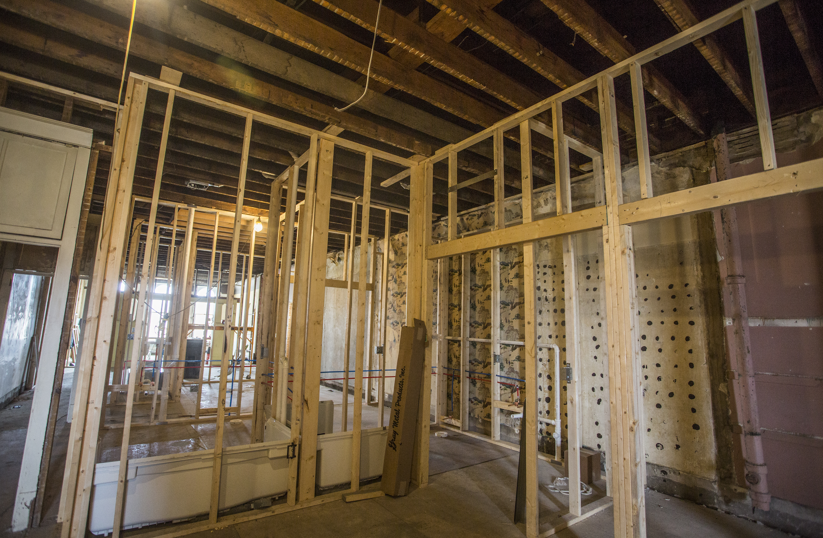
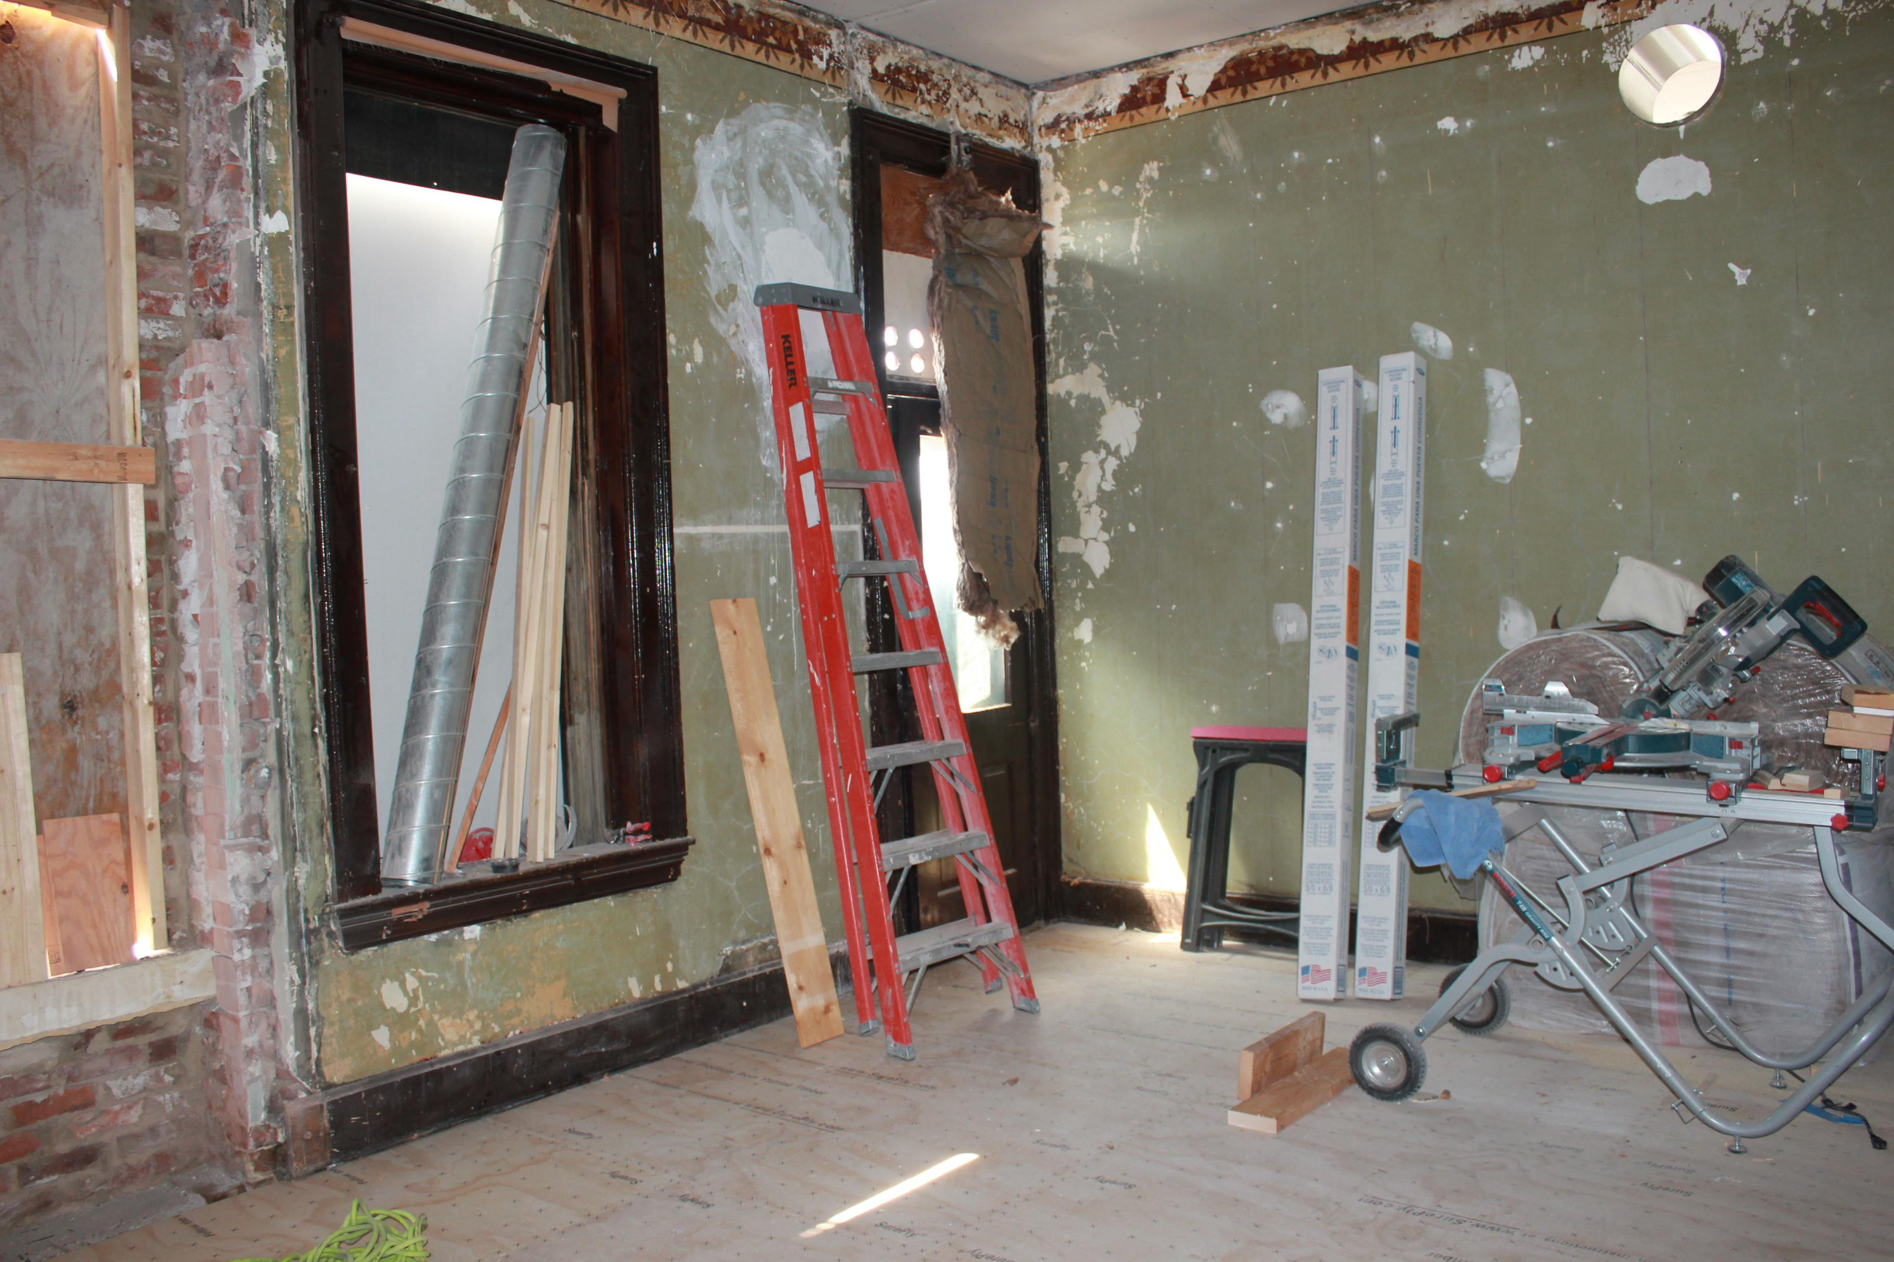
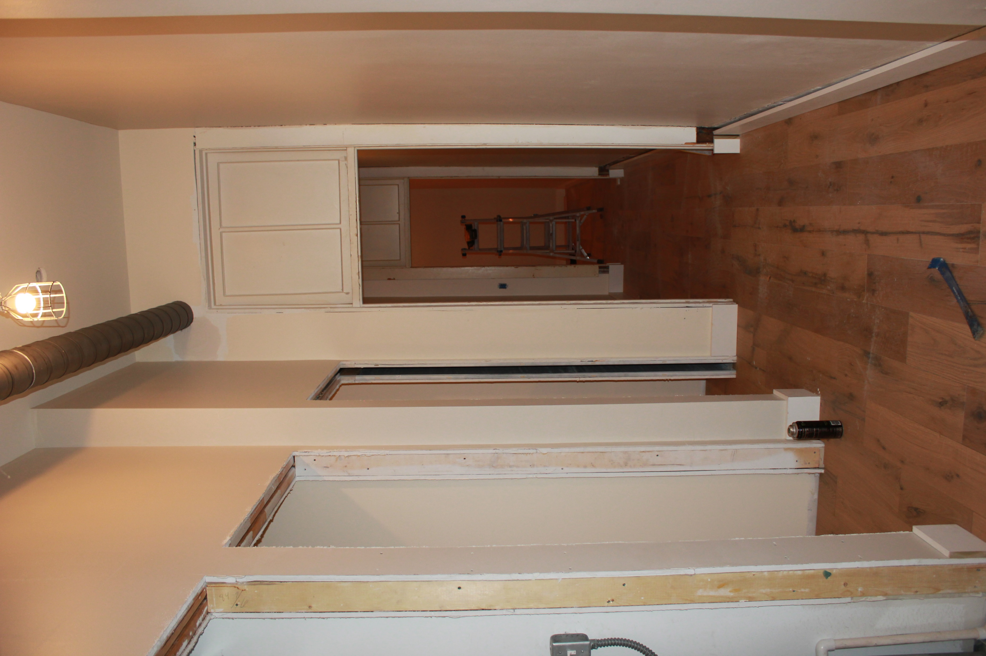
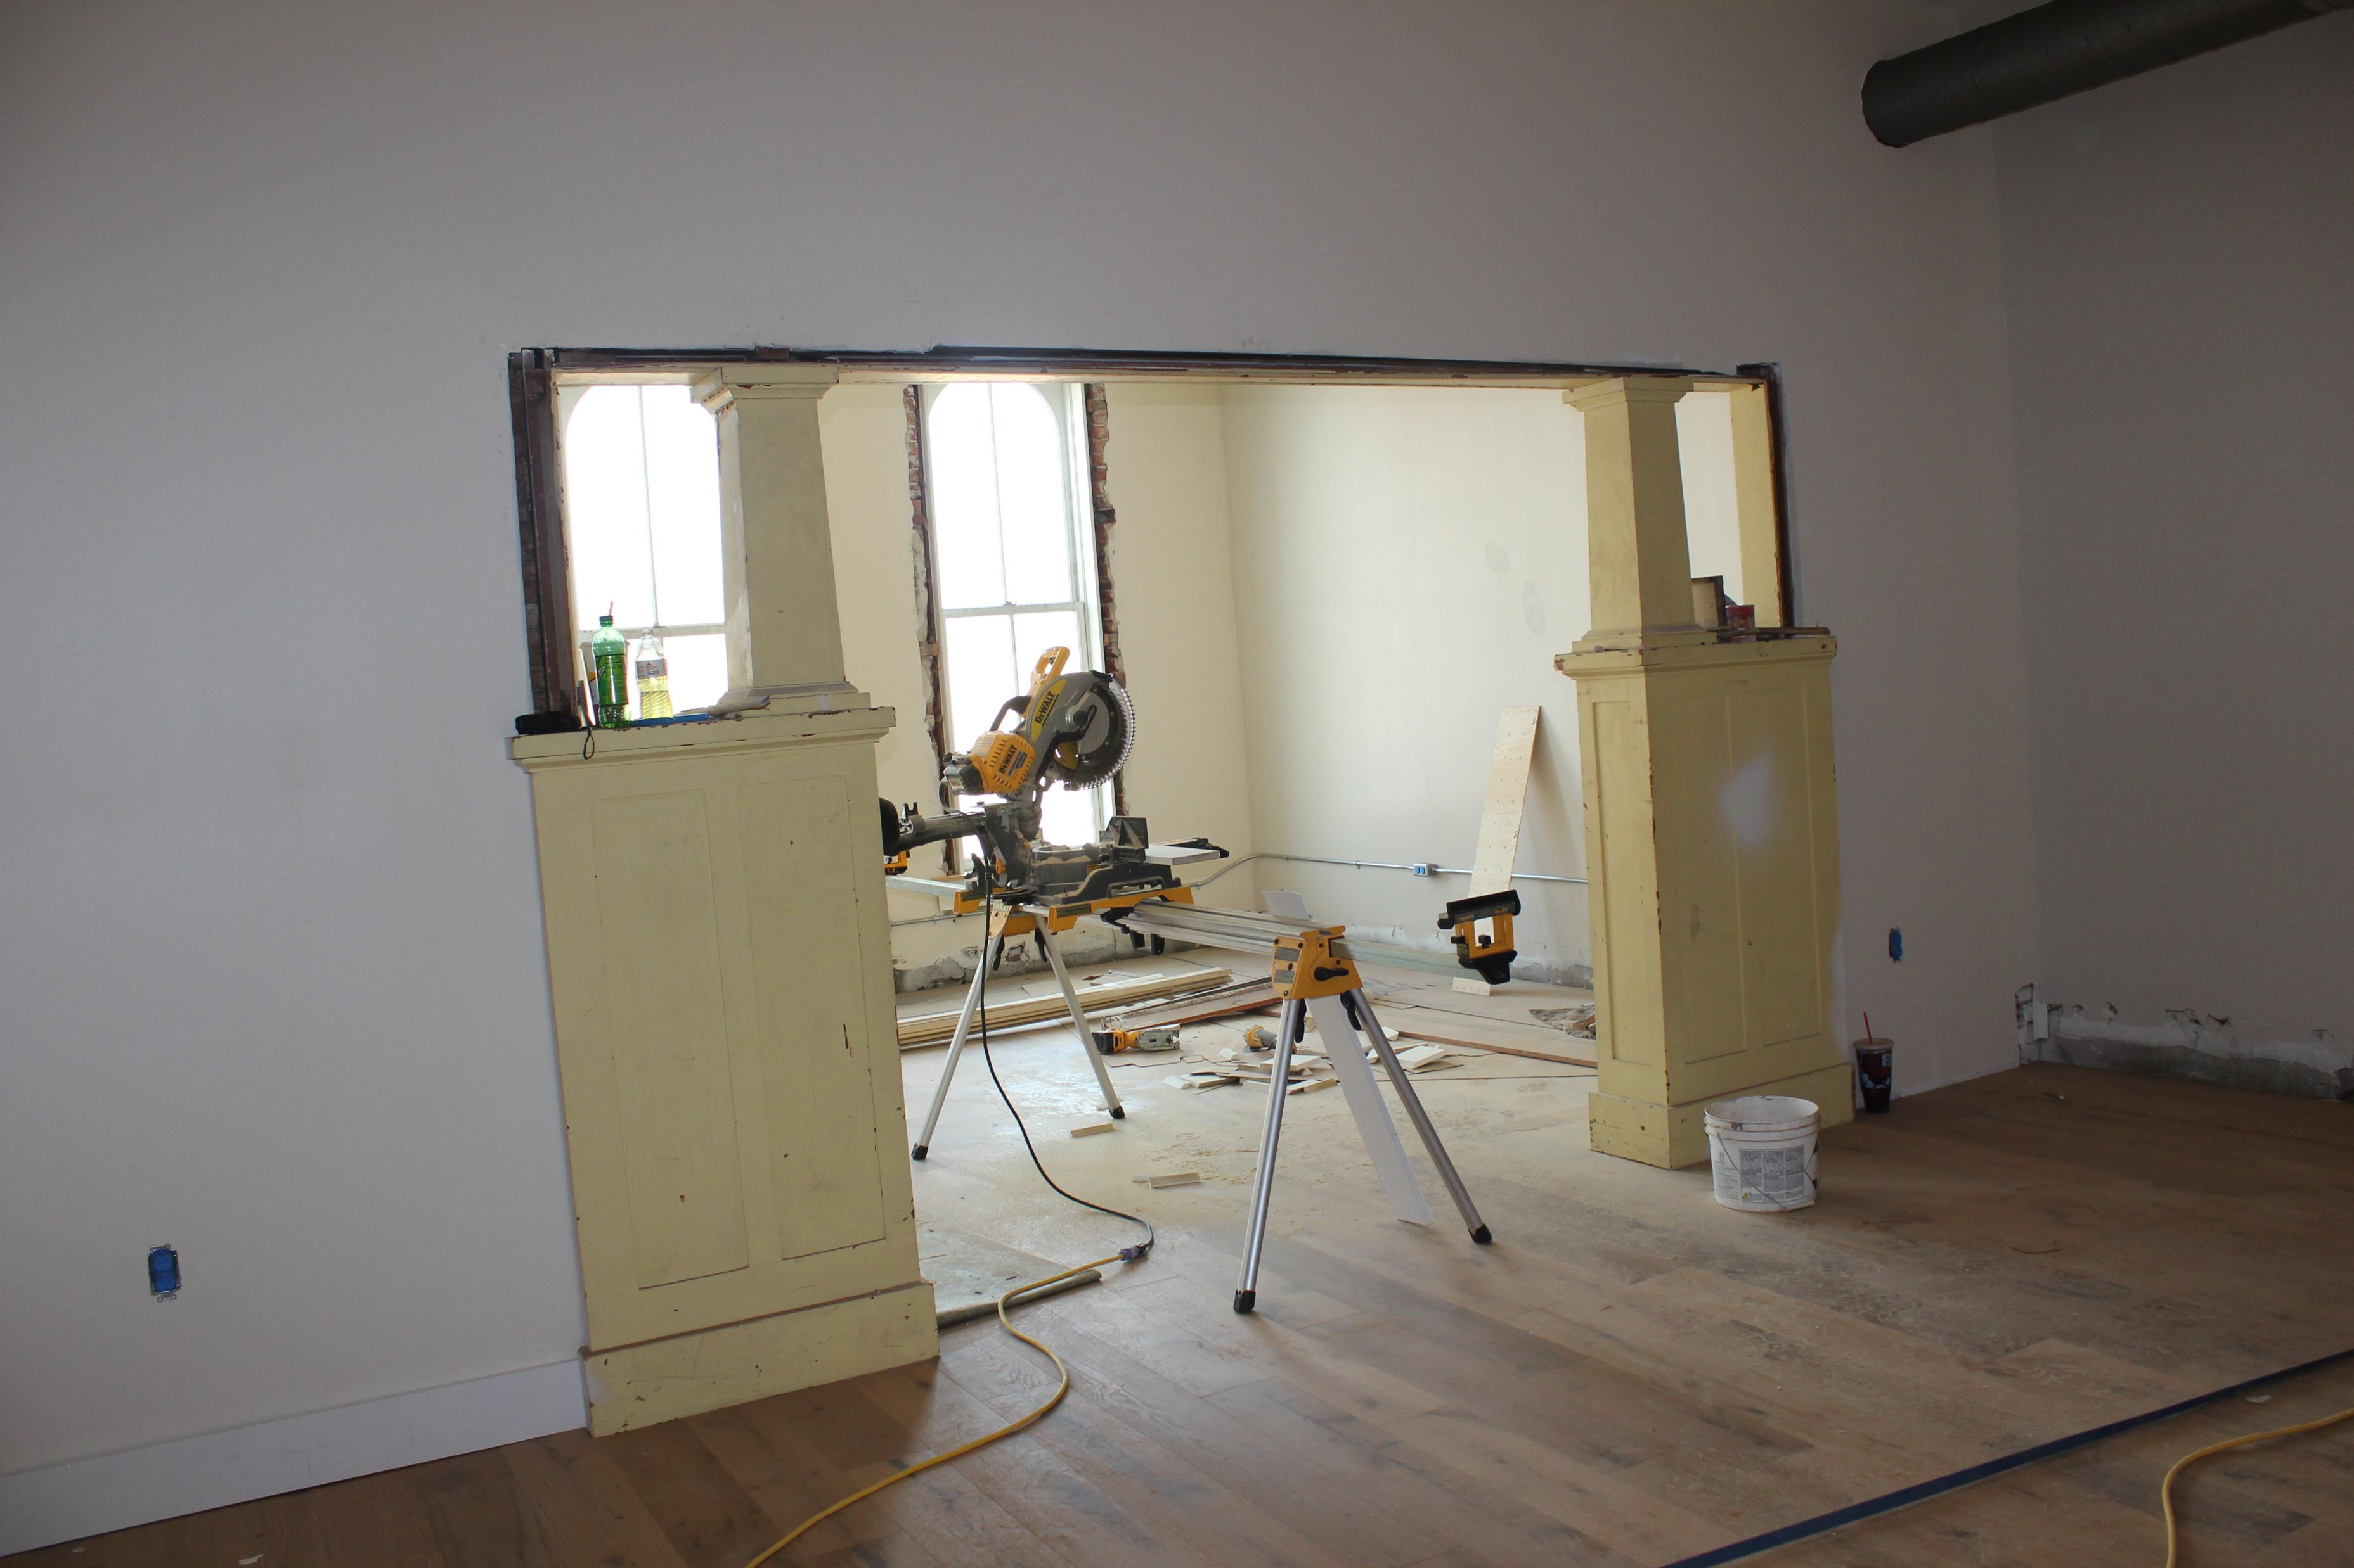
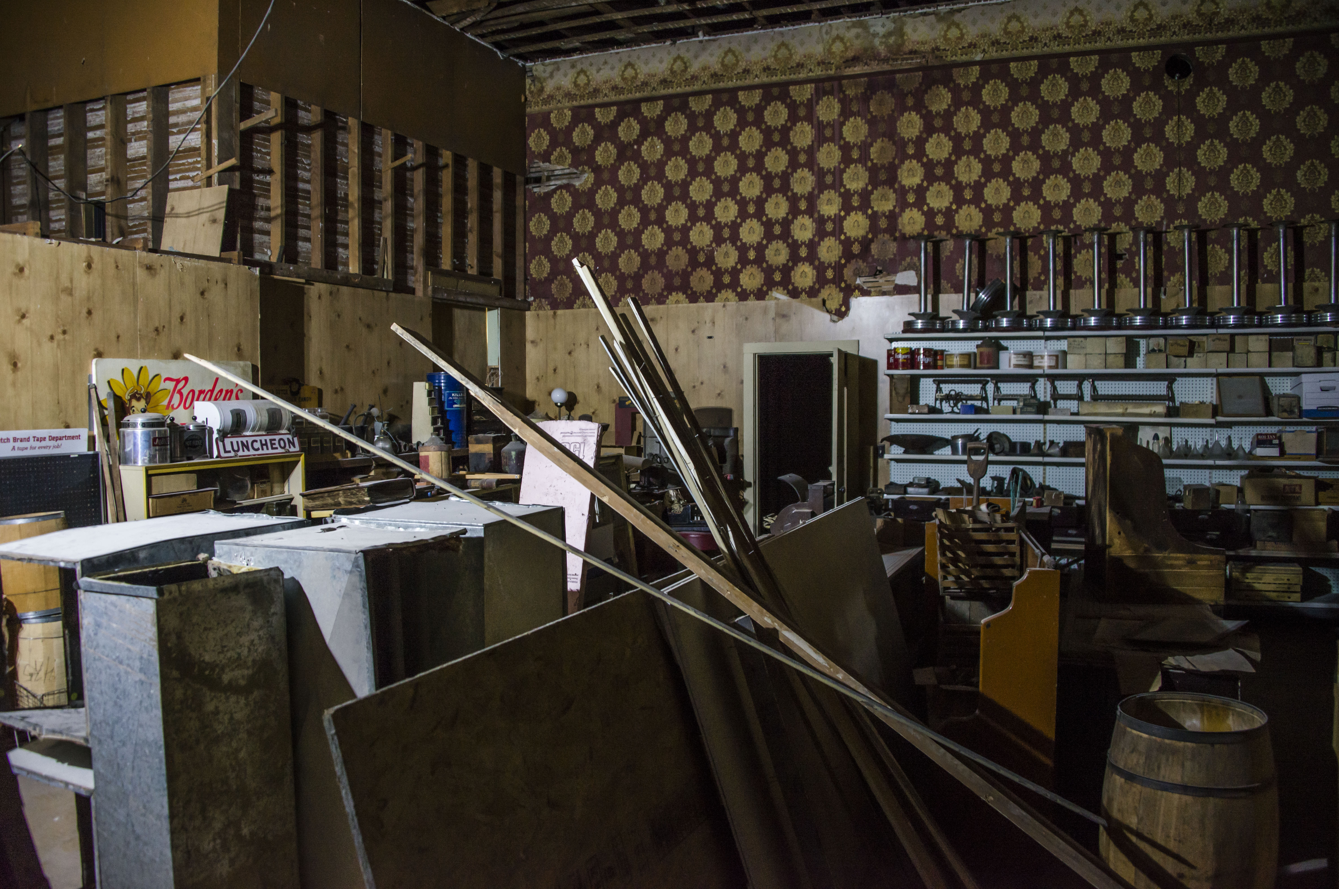
Upper Story Apartments

Slide 18
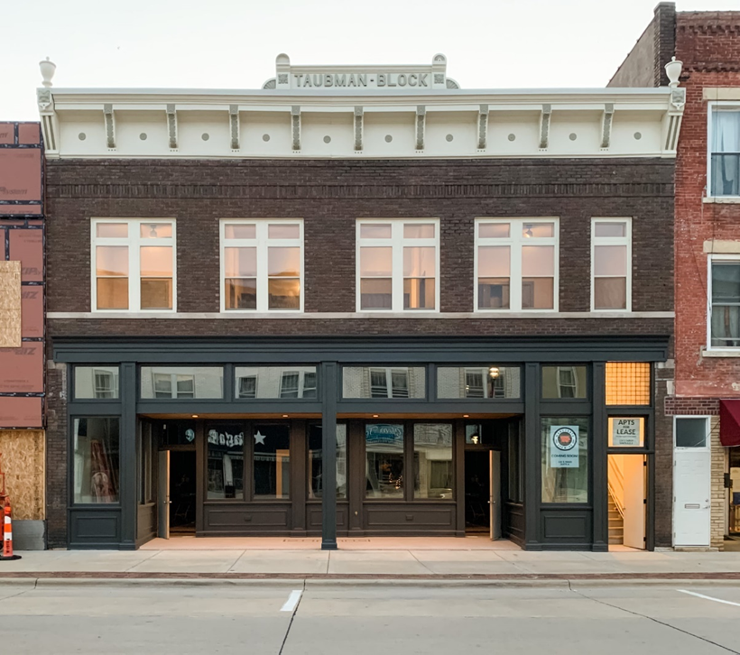
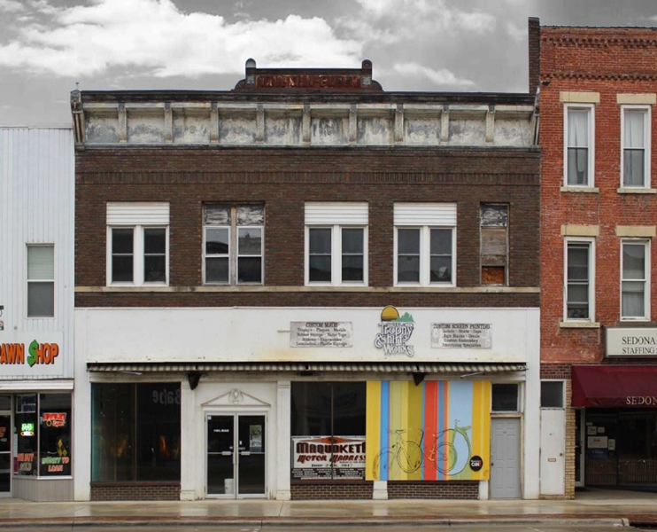

Slide 19
Other Federal Funding:
Project: Cost Federal Grant State Funding
Platt Street $12.7 million $3.8 million BUILD $5 million
Wastewater Treatment $11.9 million $600,000 CDBG
Storm Water $2.9 million $2.3million EDA
$300,000 CDBG
Trail Extension $578,000 $200,000

Slide 20
Other Smaller Jackson County Communities
Catalyst Grants (IEDA)
REAP (IDNR)
Wellmark
Community Foundation
American Rescue Plan (ARP)

Slide 21
Successful communities know how to work together and to bring partners to the table.

Slide 22
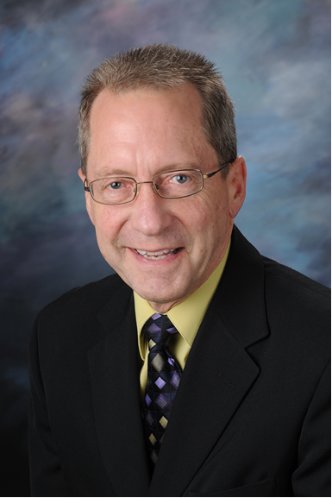
Dave Heiar
Jackson County Economic Alliance
Senior Advisor & Community Coach
119 S. Main Street, STE 5
Maquoketa, IA 52060
0: 563-652-4549
M: 563-599-1223
Email: heiar@thejcea.org

