Slide 1
Exploring Urban & Rural Definitions & Available Census Data
June 23, 2023
Kira O’Bradovich & Ana Arredondo
Data Dissemination Specialists
U.S. Census Bureau, Data Dissemination and Training Branch kira.p.obradovich@census.gov
ana.l.arredondo@census.gov

Slide 2
Meet Your Instructors
Ana Arredondo is a Data Dissemination Specialist for the Denver Region covering Houston and San Antonio, TX. She has held different roles at Census including Survey Statistician for economic surveys, Survey Supervisor for American Community Survey data collection operations in Texas, and 2020 Census Partnership Specialist. In her current role, Ana engages Census stakeholders through outreach and education.
Kira O’Bradovich is a Data Dissemination Specialist for the Chicago Region for the state of Iowa. Formerly she served as a Senior Partnership Specialist during the 2020 Decennial Census. She grew up in Omaha, the child of Iowans, and currently resides in Chicago.
She holds an LLM in Public International Law from the University of Kent, an M.S. in International Public Service from DePaul University, and a B.A. from Gustavus Adolphus College in Saint Peter, MN.

Slide 3
Overview
Overview of the Census Bureau
Census Surveys & New Releases
Urban vs. Rural Classification
Data Tools & Resources
Questions

Slide 4
The Census Bureau
1.

Slide 5
We conduct more than 130 censuses and surveys each year, including:
The Decennial Census – the once-a-decade population and housing count of all 50 states and U.S. territories
The American Community Survey – the ongoing, annual survey of the social, economic, housing, and demographic characteristics of the nation’s population
The Economic Census – the official five-year measure of American businesses providing comprehensive statistics at the national, state, and local levels
XXXX
The U.S. Census Bureau is the federal government’s largest statistical agency.
Our mission is to serve as the nation’s leading provider of quality data about its people and economy.

Slide 6
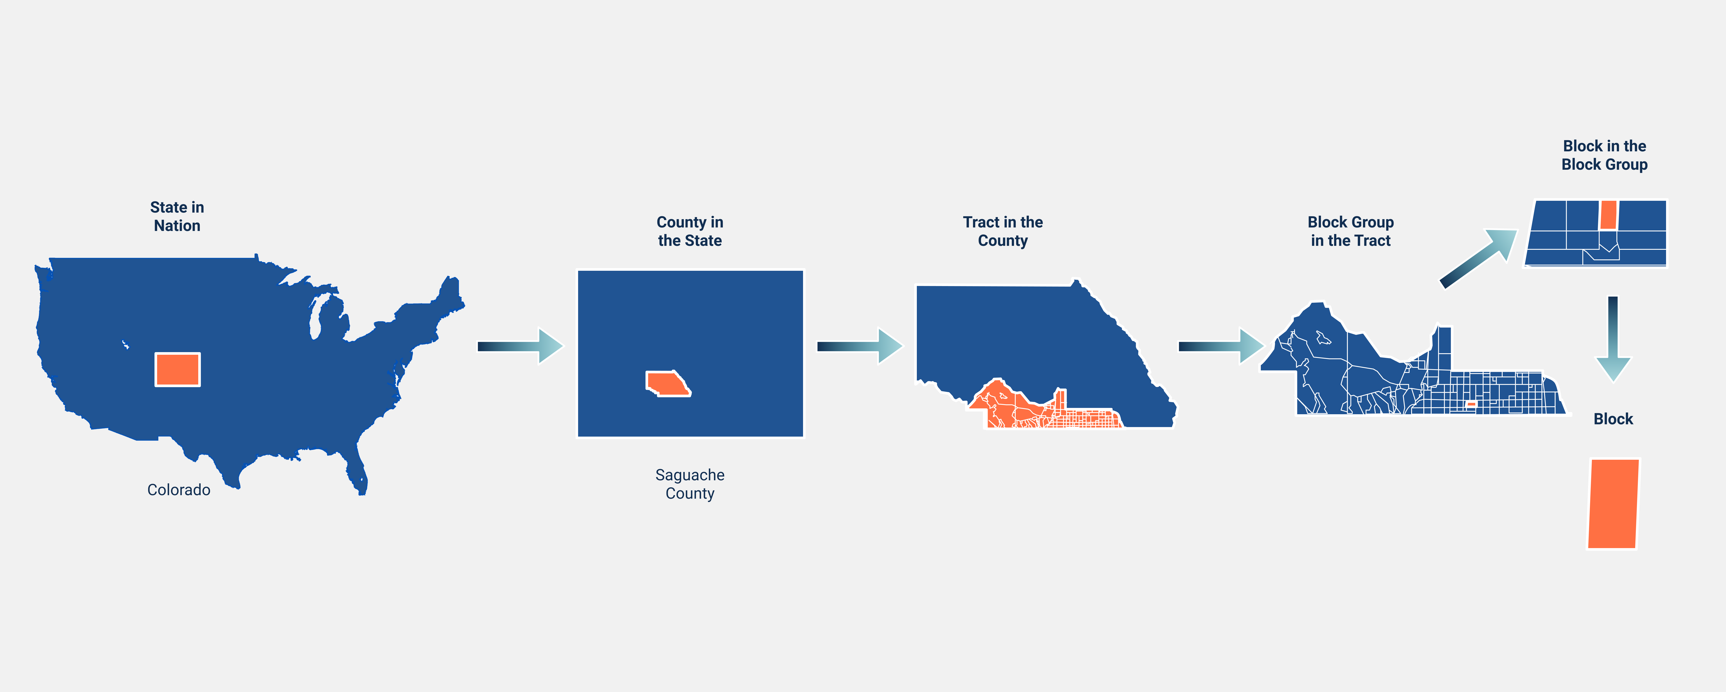
Hierarchy of Census Geography, From Nation to Block

Slide 7
Census Geographies
Nation
American Indian Areas/Alaska Native Areas/Hawaiian
ZCTA
Urban Areas
State
Congressional District
Metro- & Micropolitan Areas
County
School District
Urban Growth Area
Tract
State Leg. Dist.
Voting District
Places
(Inc. & CDP)
Block Group
County Subdivision
(CCD)
Public Use Micro-data Areas (PUMA)
Block*
*Not available for ACS data
7

Slide 8
Census Bureau Surveys
2.
Notes:
Ana

Slide 9
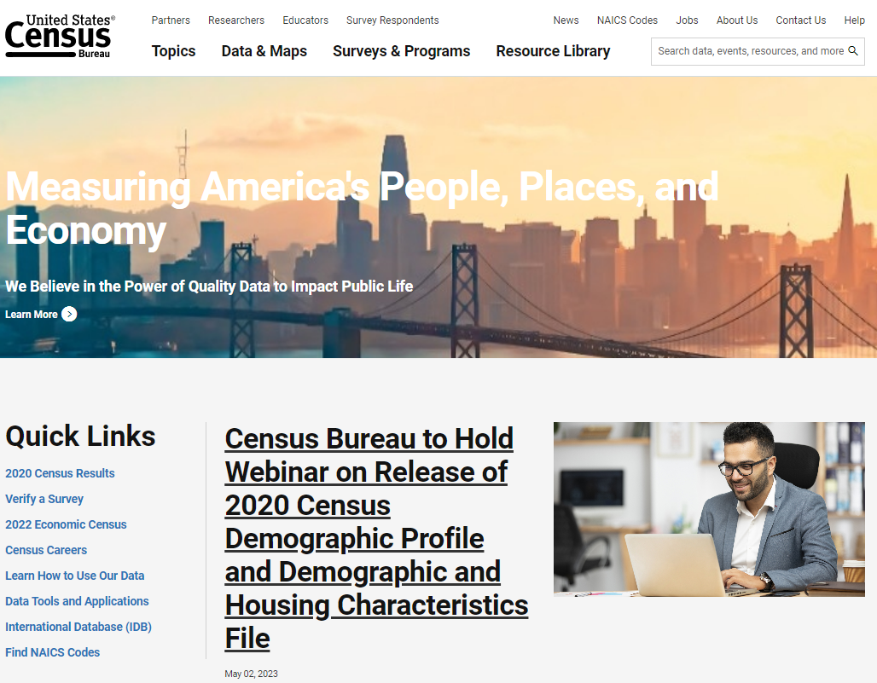
Decennial Census Data Release
Demographic Profile Released on May 25, 2023
Demographic and Housing Characteristics File (DHC)
Age & Sex
Hispanic & Latino Origin (not detailed groups)
Race (not detailed groups)
Household Type, Family Type, Relationship to Householder
Group Quarters Population
Housing Occupancy, Housing Tenure
https://www.census.gov/library/video/2023/adrm/finding-2020-census-demographic-and-housing-characteristics-data-for-urban-and-rural-geographic-components.html

Slide 10
What is the American Community Survey?
Designed to provide communities with reliable and timely social, economic, demographic and housing data every year
Conducted since the 2000s when it replaced the long-form decennial
Surveys 3.5 million addresses
Covers 40+ topics, supports over 300 evidence-based Federal government uses
Informs the distribution of $675 billion in federal funds
www.census.gov/acs
10

Slide 11
What information is collected?
Social (DP02)
Educational Attainment
Marital Status
Fertility
Grandparents
Veterans
Disability
Place of Birth
Citizenship Status
Language
Ancestry/Tribal
School Enrollment
Degree
Economic (DP03)
Income & Earnings
Class of Worker
Employment Status
Occupation
Industry
Commute
Place of Work
Health Insurance
Food stamps/SNAP
Housing (DP04)
Tenure
Occupancy & Structure
Housing Value
Taxes & Insurance
Utilities
Mortgage/Monthly Rent
Year Structure Built
Year Householder moved
Vehicles
Monthly costs
Demographic (DP05)
Total Population
Sex & Age
Race
Hispanic Origin
Citizen/Voting Age
www.census.gov/acs/www/guidance/which-data-tool/

Slide 12
American Community Survey Estimates
 | 1-year Estimates | 1-year Supplemental Estimates | 5-year Estimates
Populations of area for which data is available | 65,000+ | 20,000+ | Any
Sample size | Smallest |  | Largest
Reliability of data | Least Reliable |  | Most Reliable
How current is the data? | Most Current |  | Least Current
Available | September | October | December
Best used when | Analyzing Large Populations |  | Analyzing Small Populations, Examining Tracts & Other Smaller Geographies

Slide 13
Changing Definitions: Urban & Rural Areas
3.
Notes:
Kira

Slide 14
Urban & Rural Area Classification
Post 2020 Census
Three Key Changes:
Increase in minimum population threshold for Urban Areas
2,500 to 5,000 and added an alternative: areas can also qualify based on a minimum housing unit threshold
2. Reliance on Housing Unit Density instead of Population Density
3. Singular Urban Definition instead of Multiple
Notes:
The Census Bureau does not have or use a definition for rural areas, rural areas are simply those that do not meet the threshold to qualify as an urban area.

Slide 15
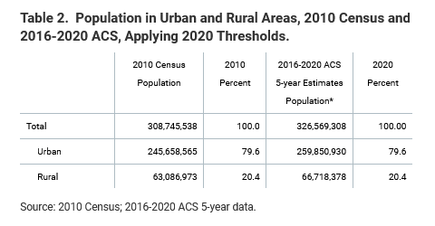
Minimum Population Threshold or Housing Unit Qualification
Urban Areas must now encompass at least 5,000 people OR at least 2,000 housing units
Minimum number of people is an increase from the former threshold of 2,500 people, which had been used since 1910
2,000 housing units was chosen as the alternative threshold because it's consistent with the 5,000 people threshold (2.5 is the nationwide average of people per housing unit)
This “either/or” approach has two benefits:
Areas, such as seasonal communities or second-home communities, that are densely developed but have a lower population on Census Day (April 1) can qualify as urban based on the number of housing units.
Areas that have higher than average people per housing unit ratios can qualify based on population.
Notes:
Remember that the Decennial is a point in time, snapshot so at times during the year, when towns are in max capacity with, for instance, snow-birds, a more complete count is needed to ensure funding for services and planning can account for this difference.

Slide 16
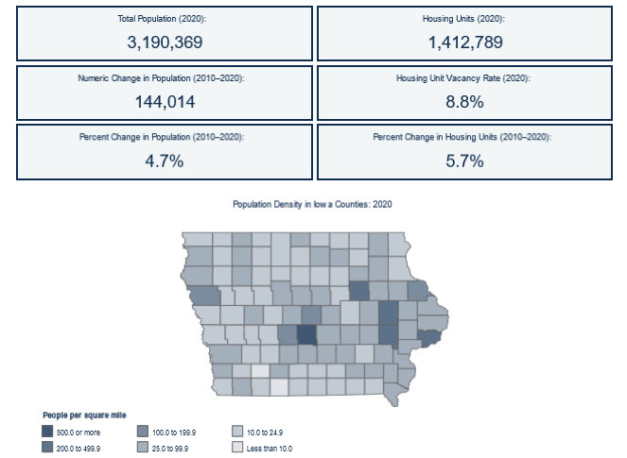
Housing Unit Density Instead of Population Density
New urban area definition is based on housing unit density measured at the census block level – 425 units per square mile
Provides a more direct measure of the densely developed landscape
More accurately accounts for areas with substantial concentrations of housing that are considered part of the urban landscape but have less than average people per housing unit or seasonal populations or both
Provides the ability to update urban areas between censuses
Notes:
A Federal Register Notice was sent out and is sent out with each Decennial if changes are suggested by the Bureau.

Slide 17
Exploring Census Data ACS Narrative Profiles data.census.gov
4.

Slide 18
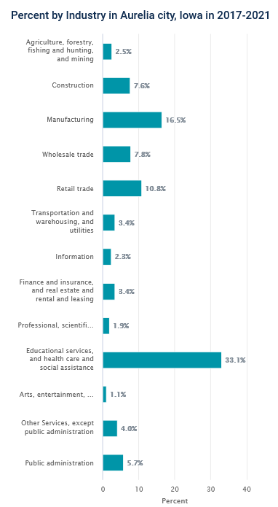
Data Tool: Narrative Profiles
-Easy-to-Use tool comprised of data from our 5-year American Community Survey Estimates
-Generates ready-made charts, graphs, & infographics to share with your customers and communities. -Covers 18 different topic areas for 9 levels of geographies including an easy address look-up tool to create highlights for your specific area
https://www.census.gov/acs/www/data/data-tables-and-tools/narrative-profiles/
Notes:
Show Cherokee Profile

Slide 19
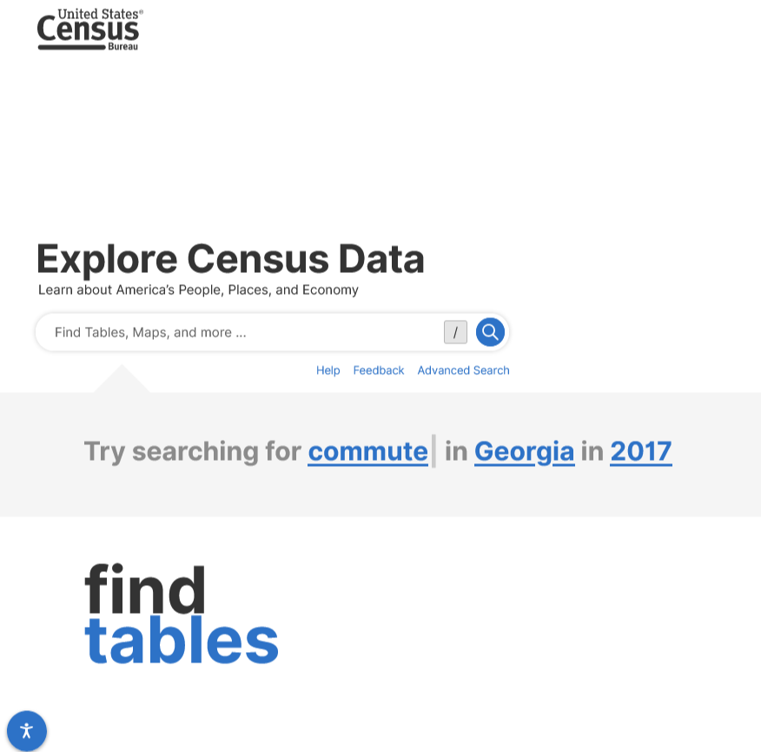
Data Tool: data.census.gov
Our Primary Data Tool sourcing from Multiple Surveys including the Decennial, Economic Surveys, & the American Community Survey
Includes a Wide Variety of Geographies including County, Place, Census Tract, & many others
Provides Profiles, Maps, & Detailed Tables with Easy to Download Data

Slide 20
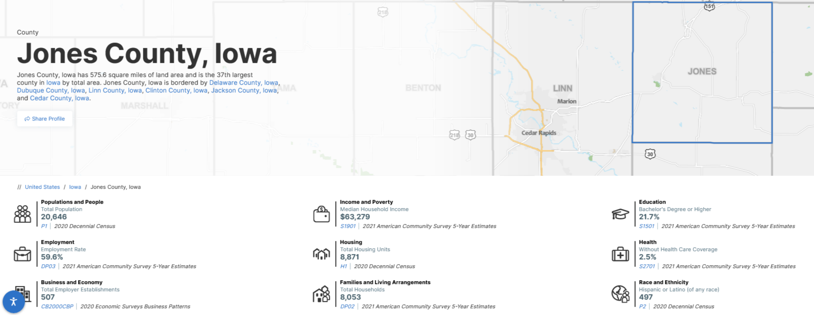
Data Tool: data.census.gov Data Profiles

Slide 21
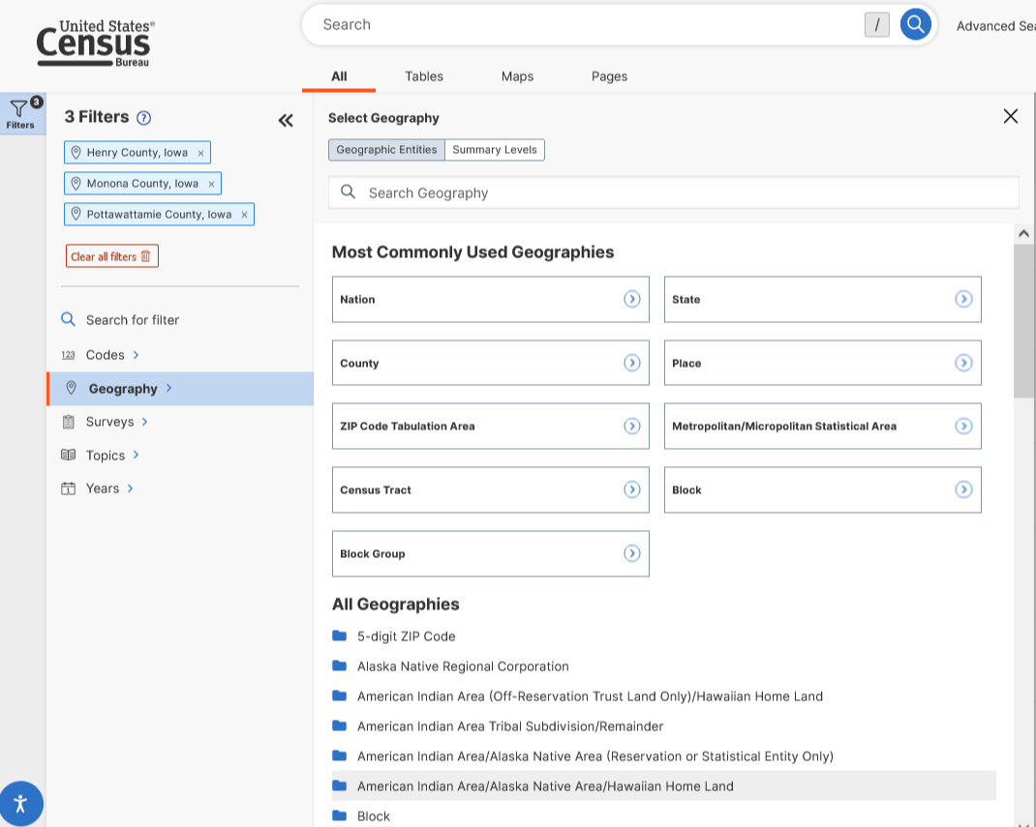
Data Tool: data.census.gov Advanced Search
-If you have a specific geography that you need data for, always start with the geography filter to narrow down the data and tables available.
-You can add in multiple geographies or any of the other filters and easily delete them on the left side where they are listed by clicking on the “x” next to each.
-You can also use the top tabs to click between tables, maps, and pages that are available for the filters you set.

Slide 22
Demonstration
Use data.census.gov to discover the data that highlights the household totals reflecting Iowa’s newly designated Urban places
Steps –
Advanced Search
Geographies: Cherokee, Harlan, Manchester, Shenandoah, Vinton
Surveys: Decennial Census: Demographic & Housing Characteristics
Table Selection: Table H12 Tenure by Household Size
Notes:
https://data.census.gov/table?g=160XX00US1913080,1934500,1948810,1972525,1981210&d=DEC+Demographic+and+Housing+Characteristics&tid=DECENNIALDHC2020.H12
Kira

Slide 23
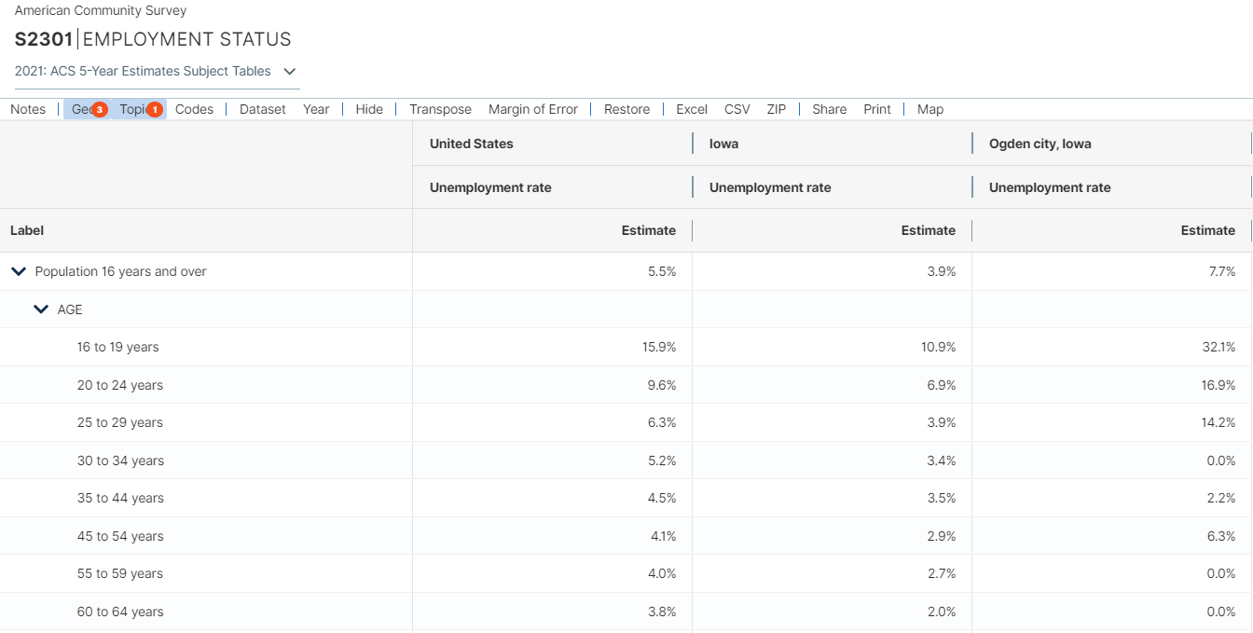
Challenge
Compare and identify economic measures related to employment, poverty and low education.
Geographies: US, Iowa, Ogden
Topics: Employment, Employment and Labor Force Status
Table: S2301
Notes:
https://data.census.gov/table?t=Employment+and+Labor+Force+Status&g=010XX00US_040XX00US19_160XX00US1958665&tid=ACSST5Y2021.S2301&moe=false
Hide columns- MOEs, total, employment participation, employment/population estimates Leave only Unemployment Estimate per geo.
ACS 5-yr estimates
Highlight for Clarinda and Shenandoah:
Unemployment rates above national and state average
% of unemployed below poverty level status are higher than national and state average % of unemployed with low education are higher than national and state average

Slide 24
Questions
5.

Slide 25
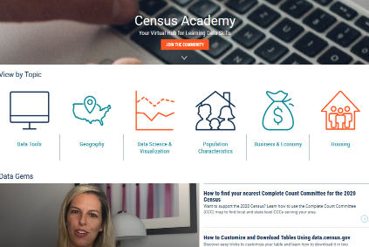
Census.gov/Academy
Data Dissemination and Training
Bring our data experts to you.
Request a free data training for your organization.
Receive our Data Gems.
These short “how-to” videos are an easy and quick way to increase your knowledge of Census data. Get them in your inbox!
Get access to our Courses.
You will learn-at-your-own-pace with these video-tutorials designed for different skill levels.
Interact with our instructors via Webinars.
Learn about our data releases and tools while attending these live virtual classes.
Contact us:
Census.askdata@census.gov
1-844-ASK-DATA
Share your ideas and feedback at census.academy@census.gov

Slide 26
Get in Touch With Us
Kira O’Bradovich
kira.p.obradovich@census.gov
202-819-2394 Iowa
Census.askdata@census.gov
1-844-ASKDATA
@uscensusbureau
Subscribe: Census.gov/academy
Let Us Know How We Did! Please complete the Follow-up Survey here!

Slide 27
THANK YOU

