Slide 1


Slide 2
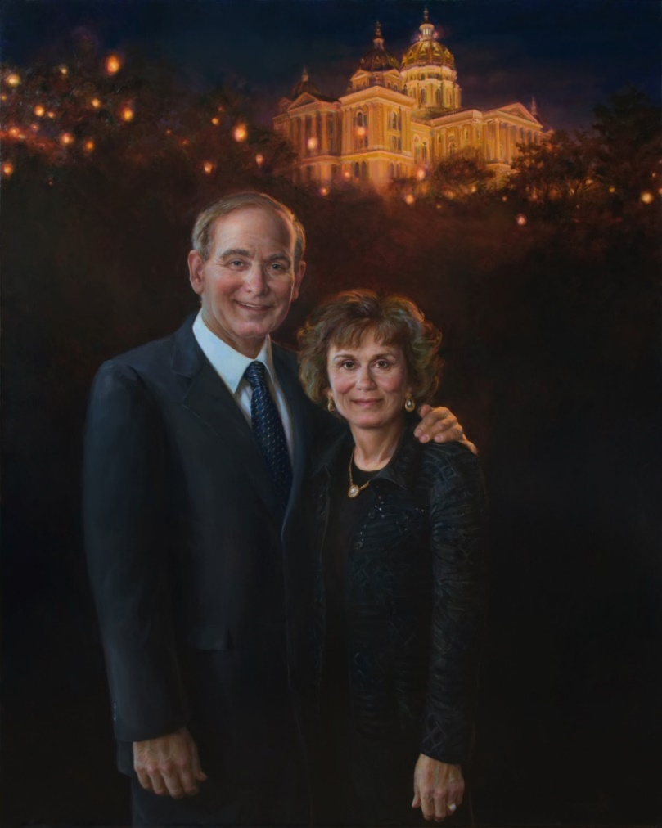
The Robert D. and Billie Ray Center mission is to improve civility through character development and ethical leadership.
The Ray Center vision is to transform lives and
strengthen communities
by equipping individuals and communities to embrace and practice good character by demonstrating trustworthiness, respect, responsibility, fairness, caring and citizenship.

Slide 3



Notes:
CHARACTER COUNTS! is a community based framework built on the foundation of the Six Pillars of Character. CHARACTER COUNTS provides practical strategies, curricular resources, and trainings to positively impact schools, community, youth-serving or people-helping organization.

Slide 4
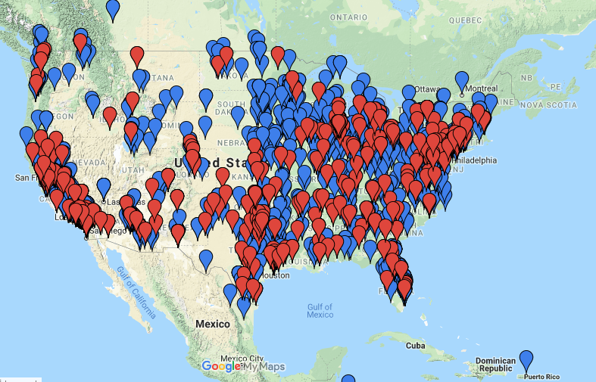

Slide 5
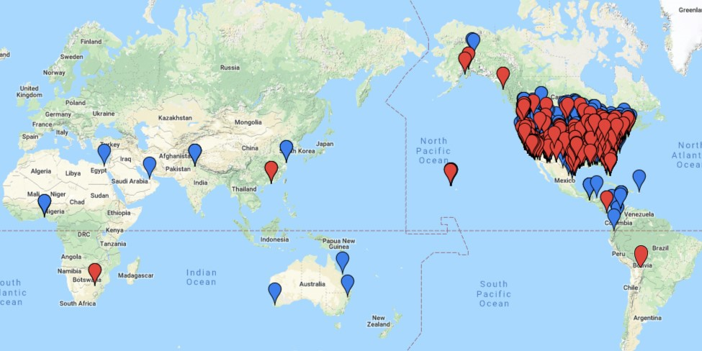
Global Impact
Outreach to over 8 Million Youth

Slide 6
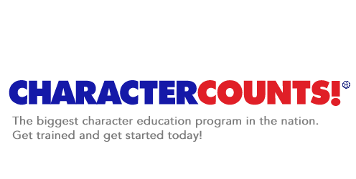
T.E.A.M.
Teach
Enforce
Advocate
Model

Slide 8

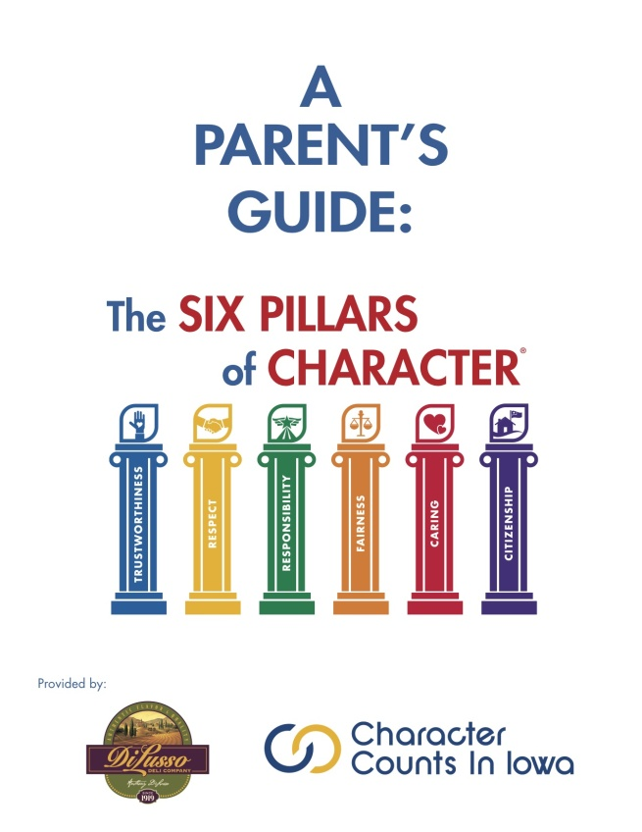
Family Resources
Character is developed first and foremost in the home.

Slide 9
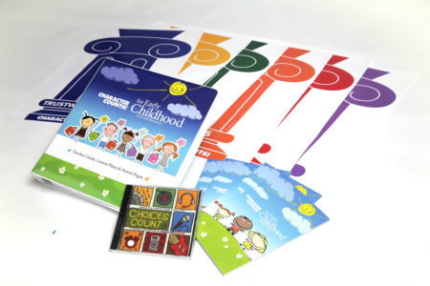

Slide 11
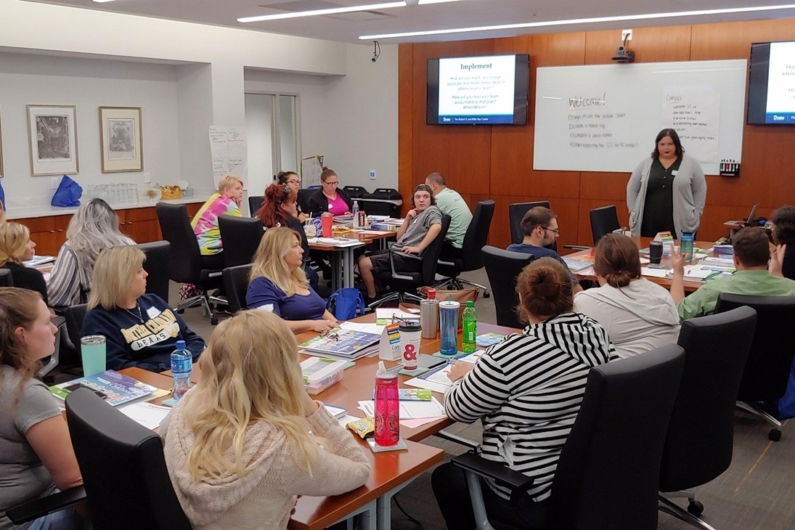

Slide 12
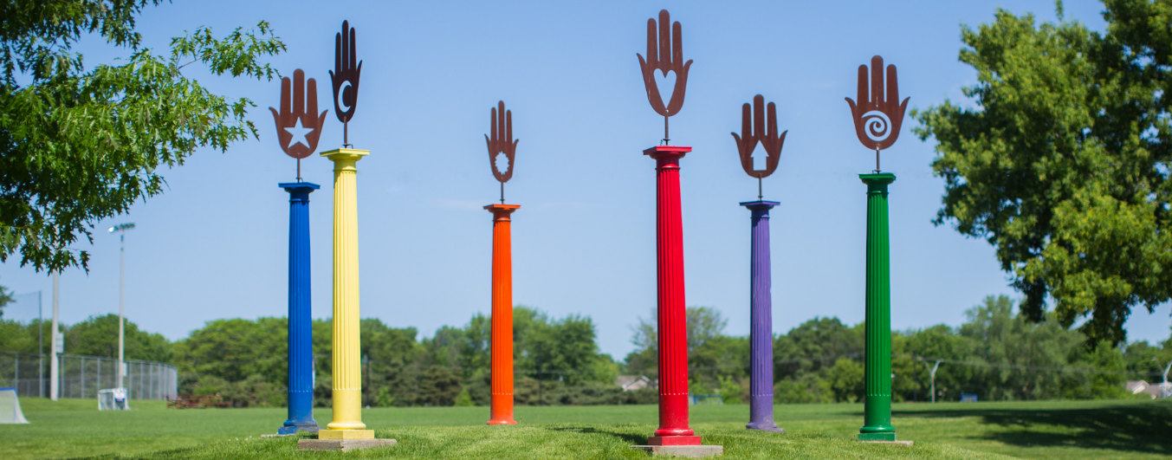
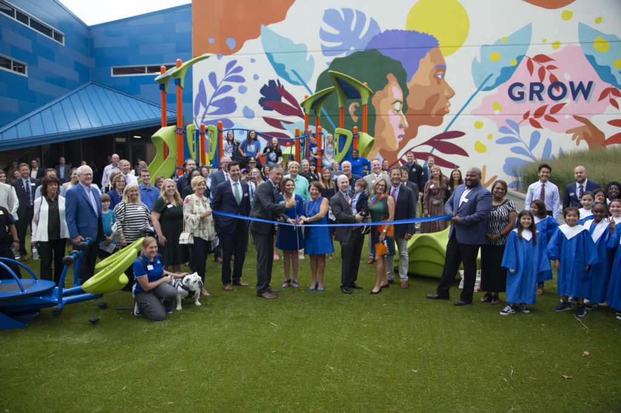
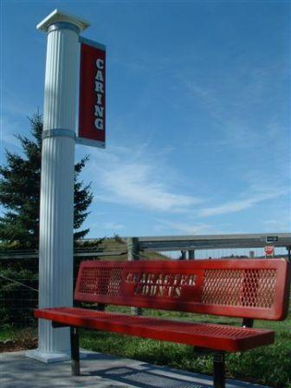
Community
Engagement

Slide 13
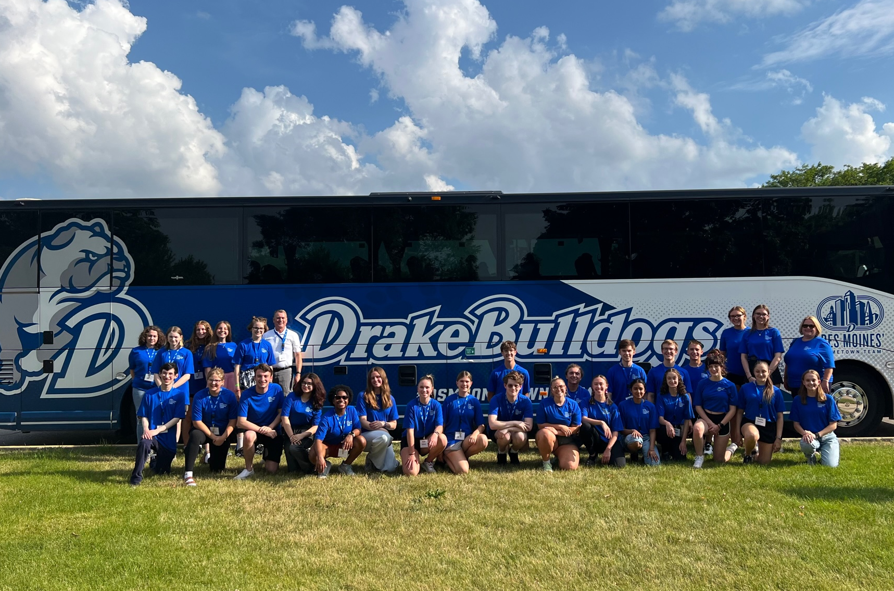
Civic Leadership Academy

Slide 14
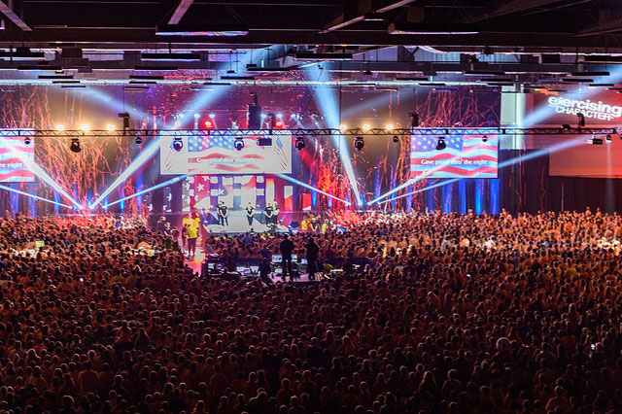



Slide 15
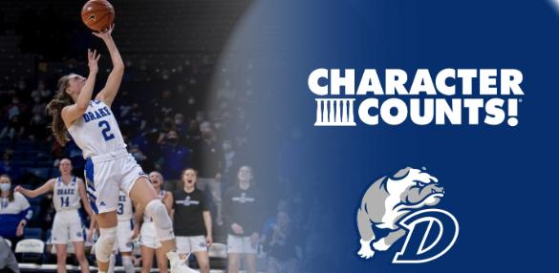
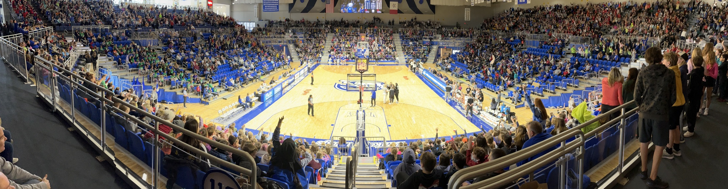

Slide 16
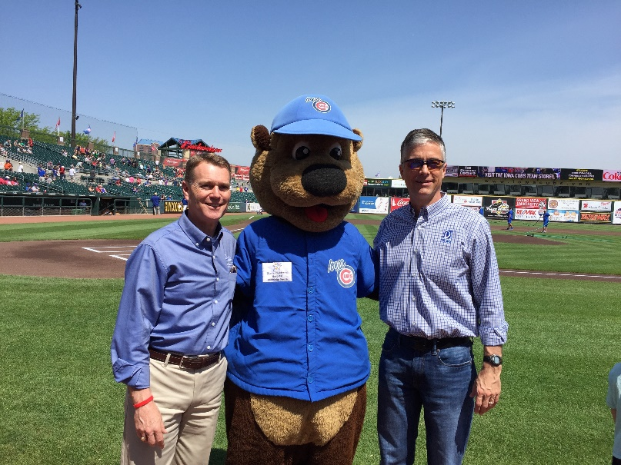
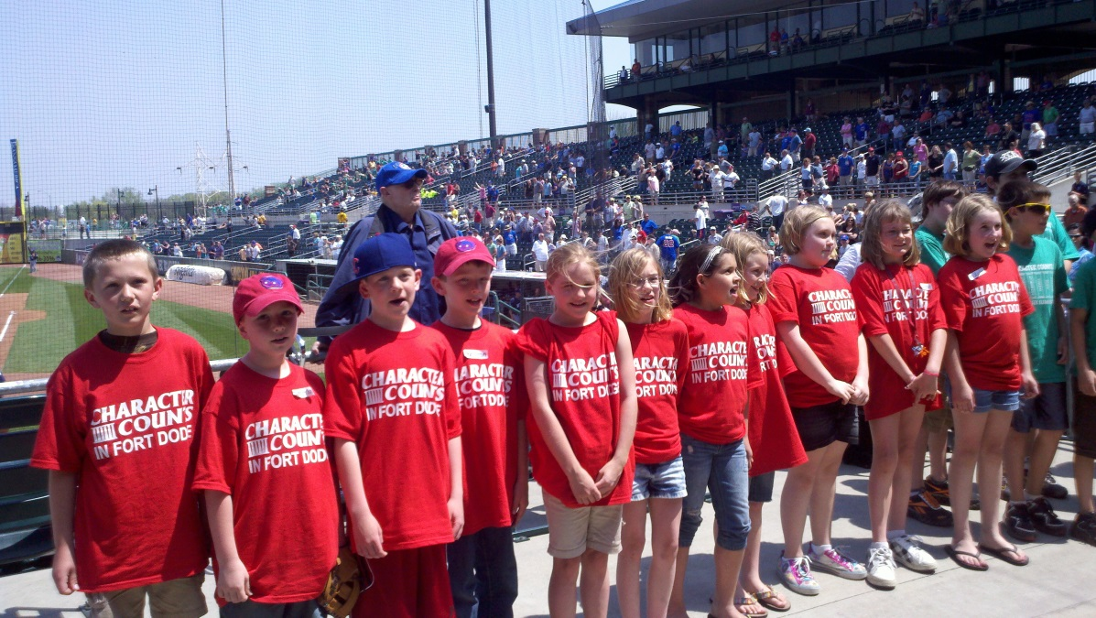
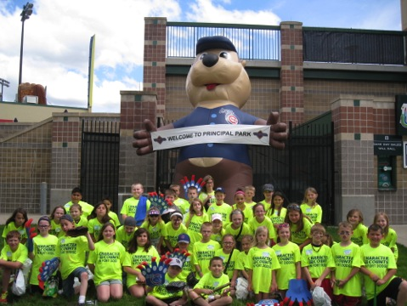
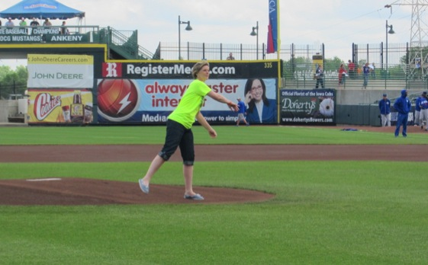
CHARACTER COUNTS! at the Ball Park

Slide 17

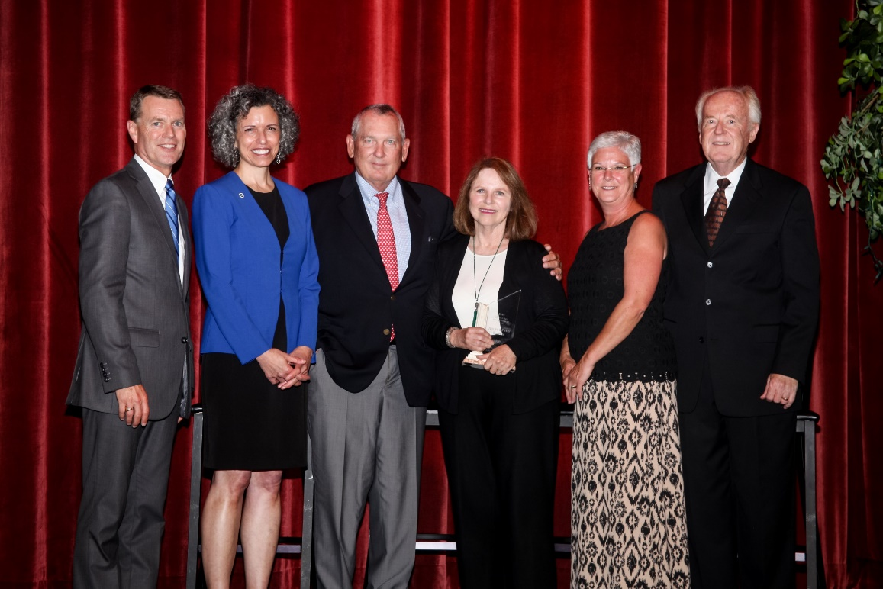

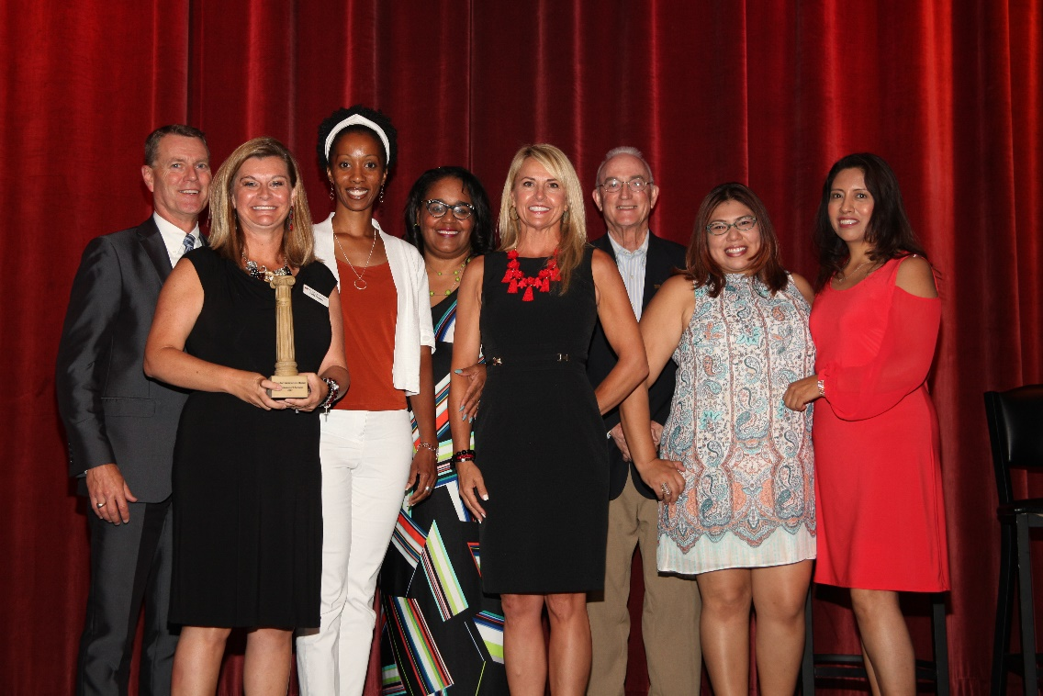
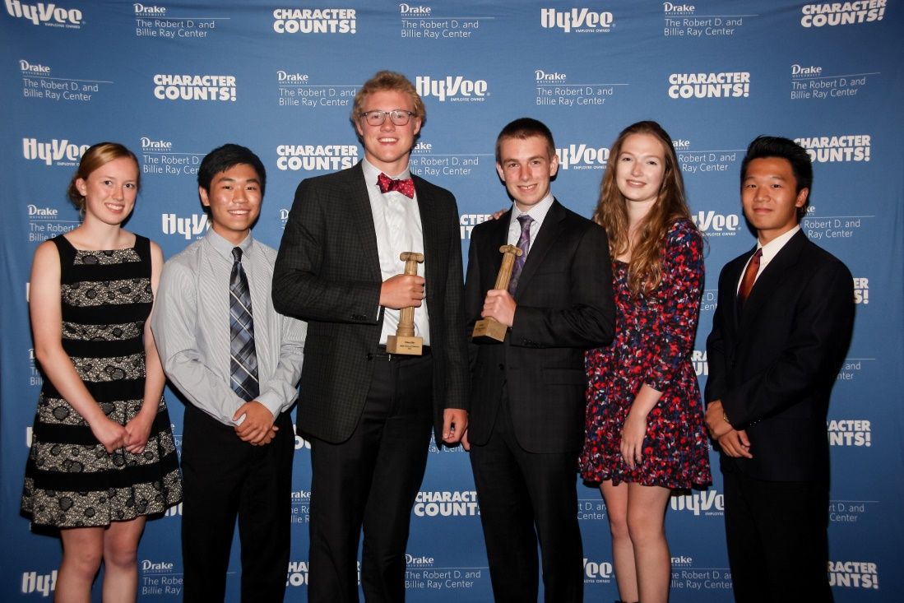

Slide 18


Slide 19
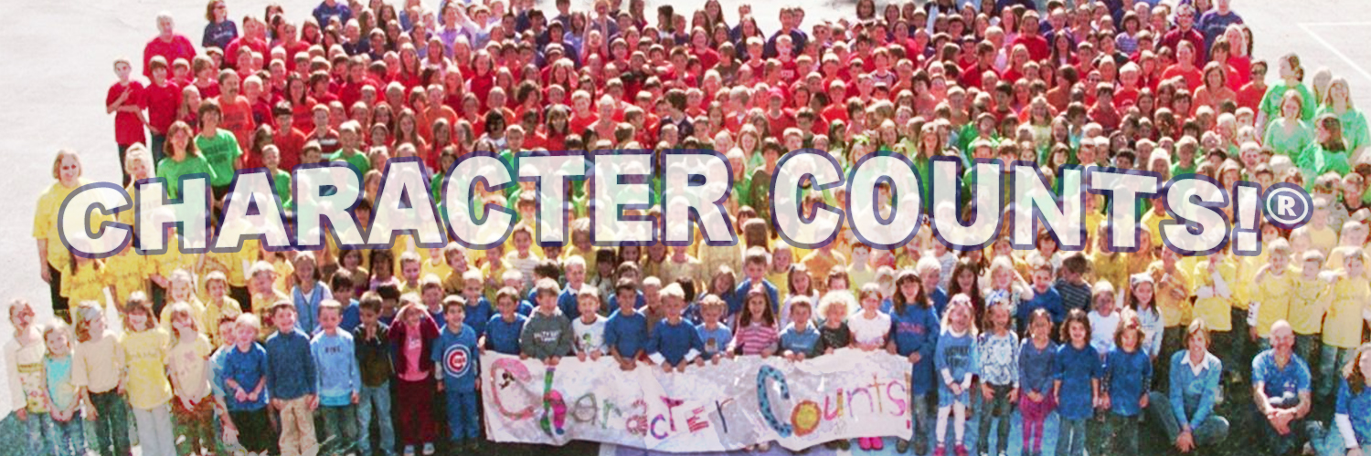
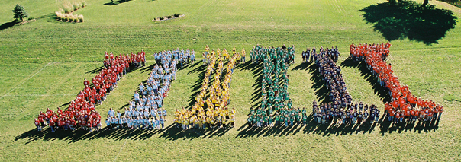
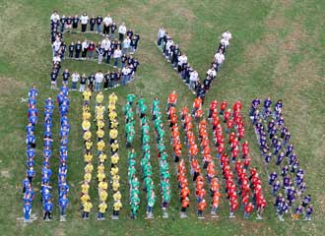
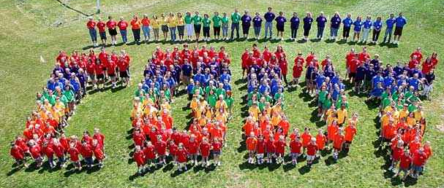

Slide 21
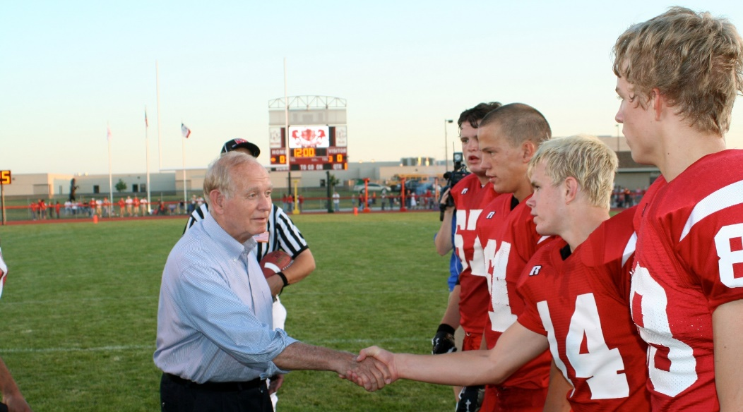
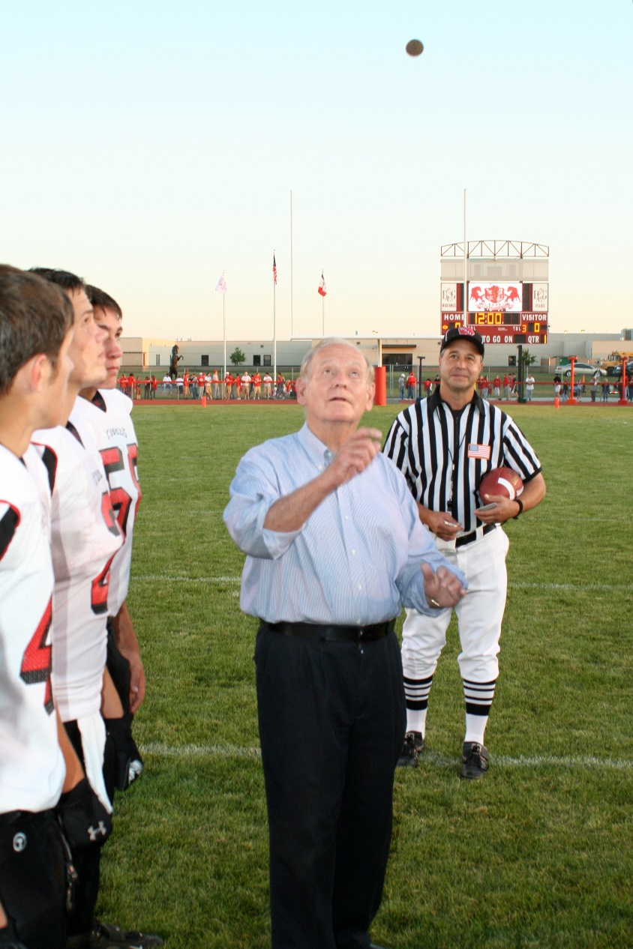
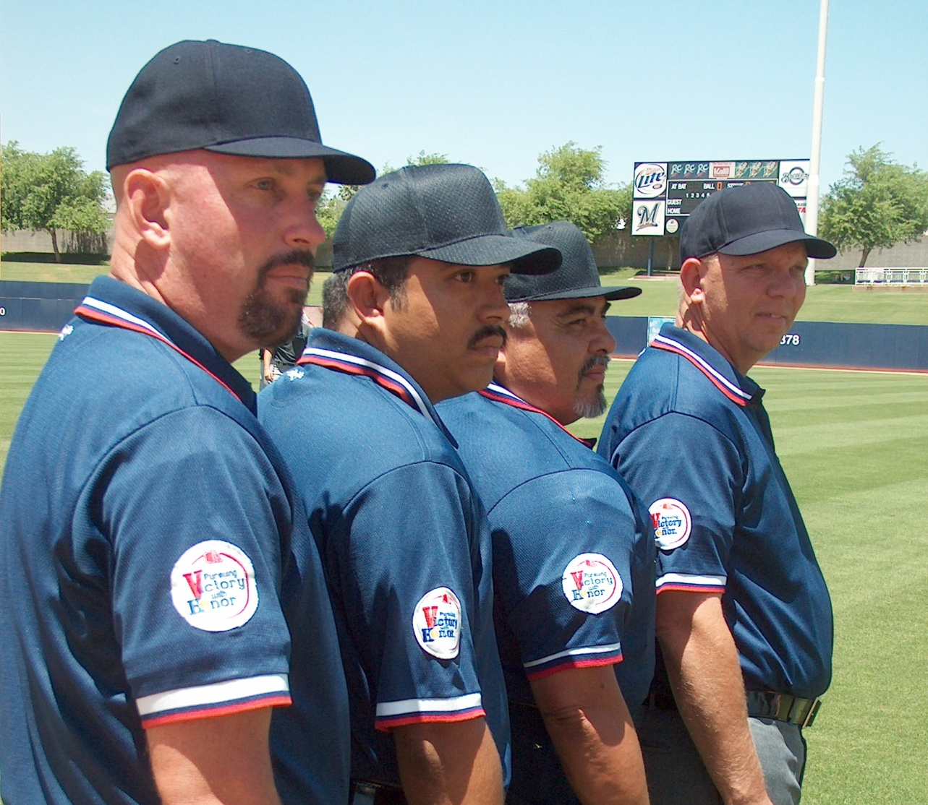

Slide 22

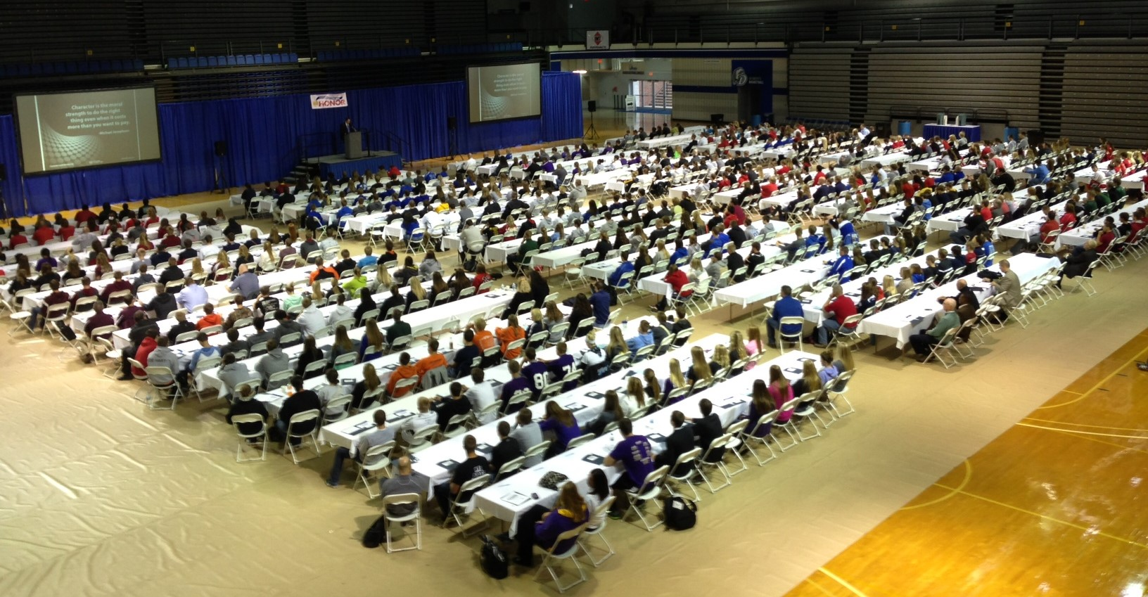



Slide 23
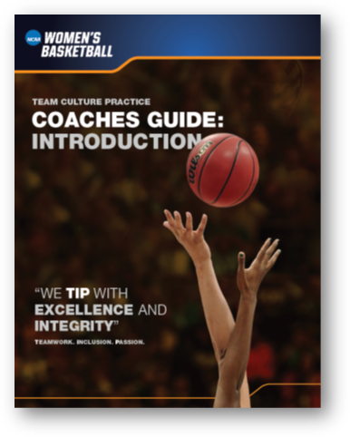


Slide 24


Slide 25
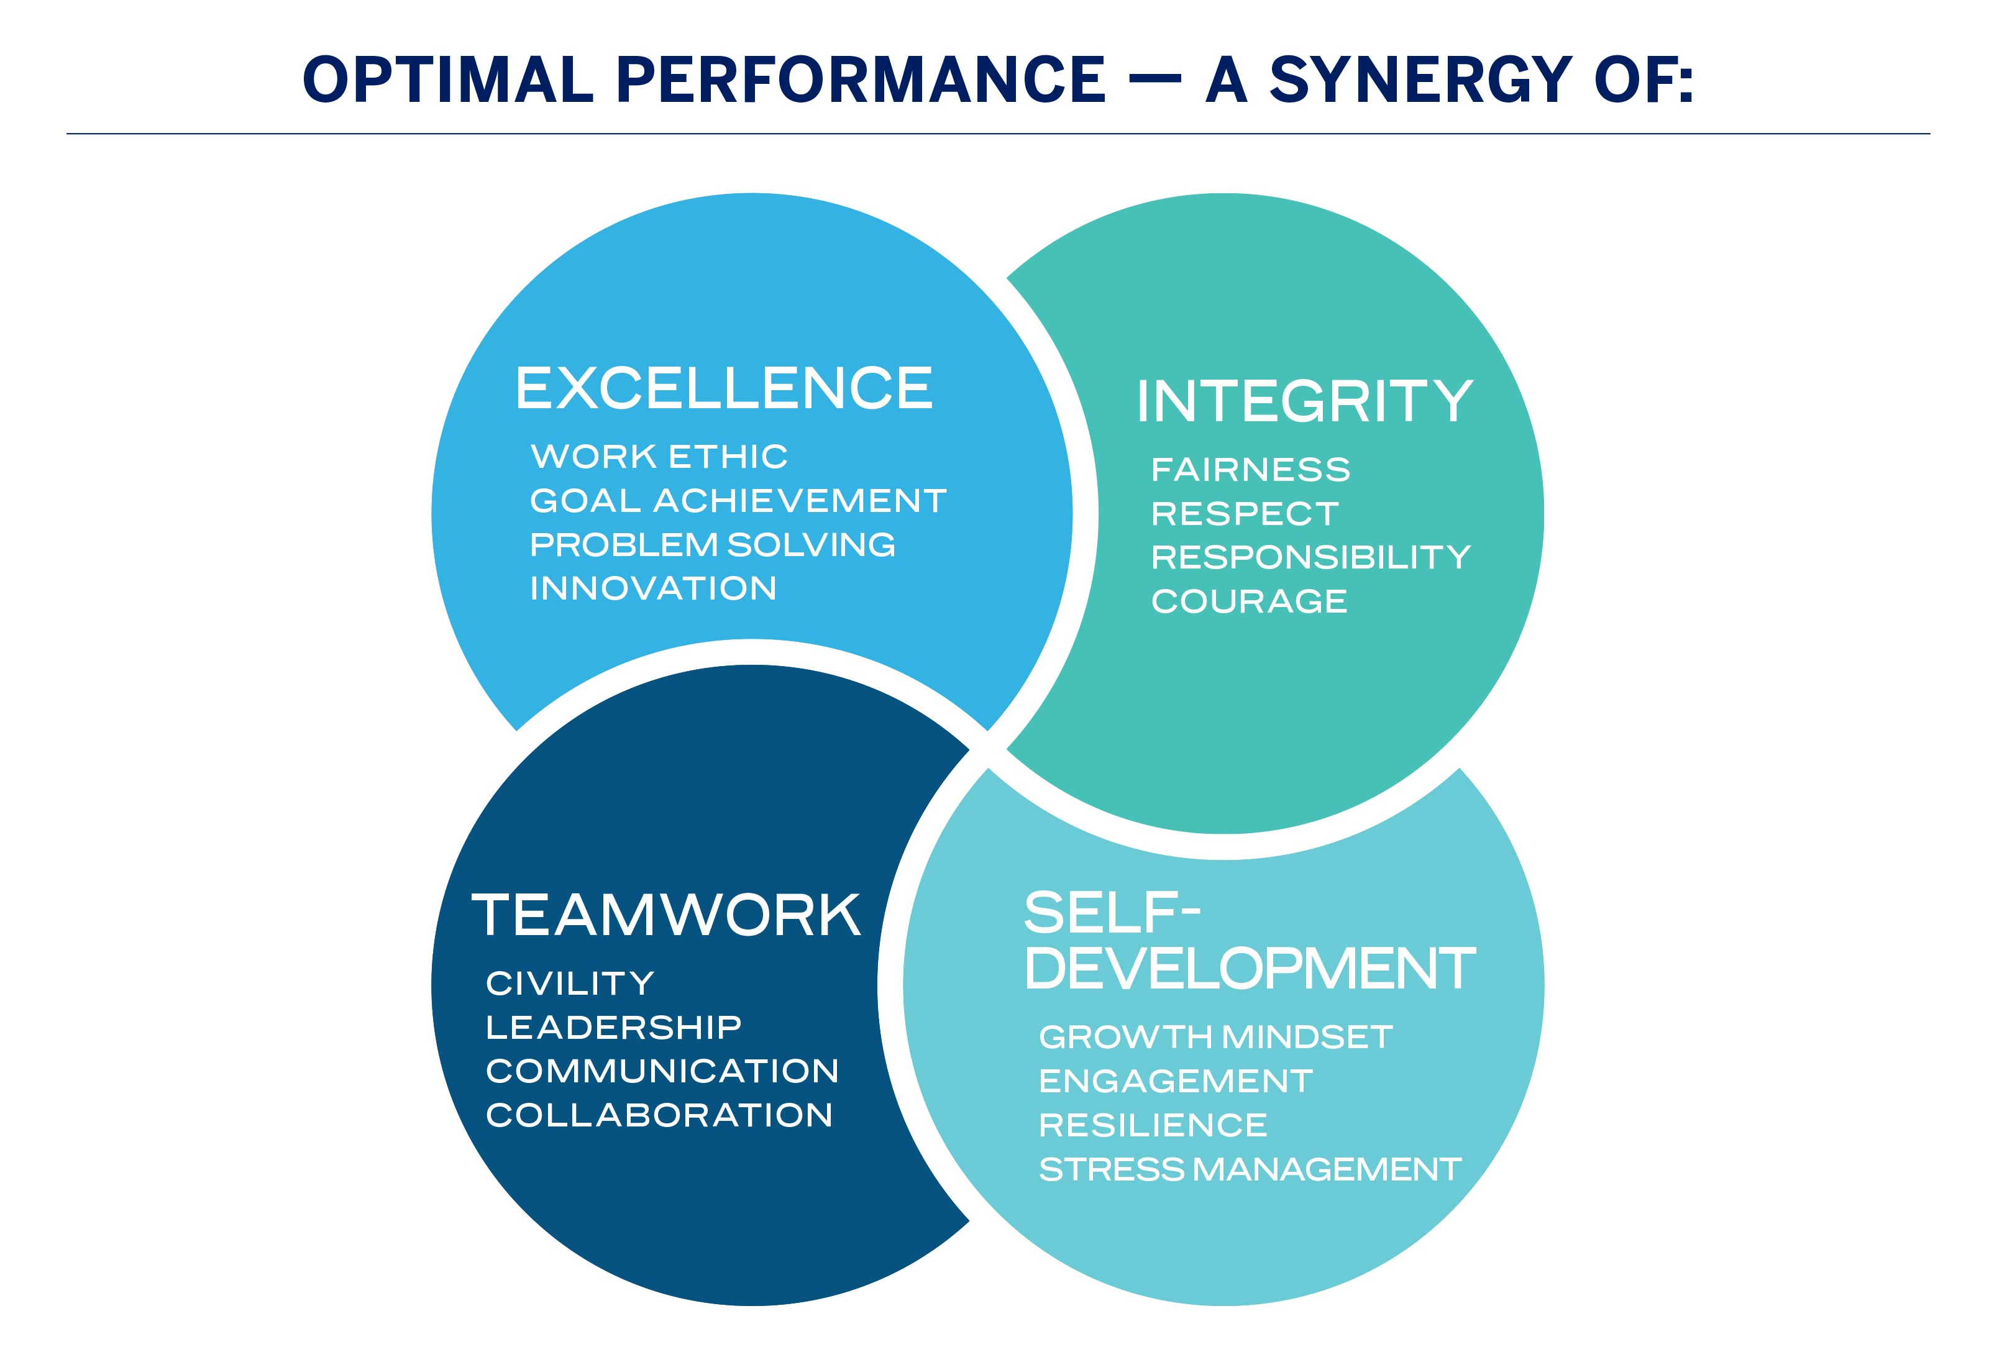

Slide 26
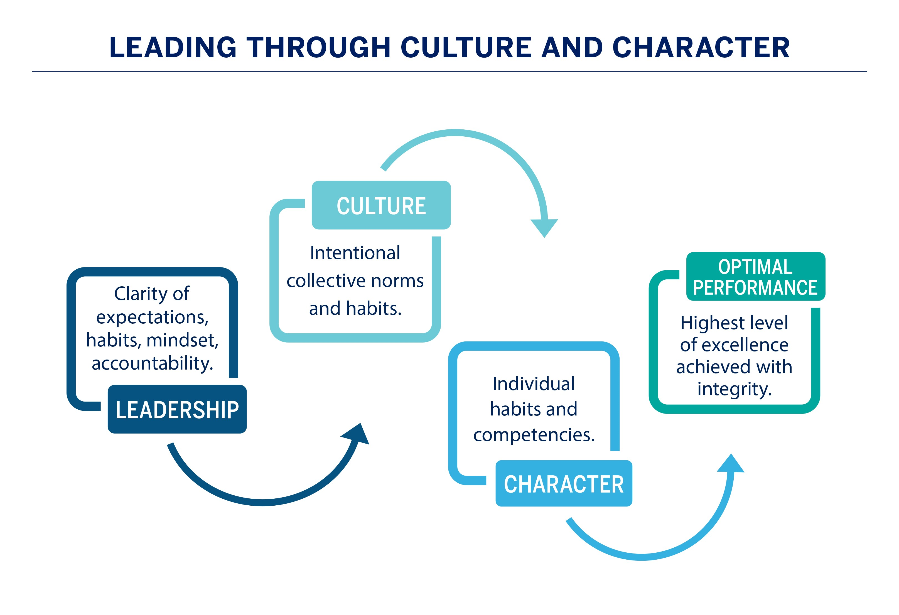

Slide 29








Notes:
The Ray Center has vast experience in leadership assessment and training with significant national impact organizations that include and are not limited to:
Hy-Vee, Inc. – executive leadership training and assessment to this regional grocer/retailer that has over 85,000 employees. Hy-Vee is listed by Forbes as the 27th largest private company in the US with over 9.6 billion in annual revenue.
Principal– company-wide assessment and executive leadership training to CPA and financial executives at this financial services and insurance organization that employees over 14,800 employees globally with over $12.53 billion in annual revenue. Principal is listed as #98 of the world’s best employers and #125 of America’s top public companies by Forbes.
Prairie Meadows – professional development and optimal performance assessment for all 1,400 employees focused on core leadership competency development to impact retention and succession planning.
Greater Des Moines Partnership – assessment on workplace culture for this business association that includes 4,700 business in 22 regional Chambers of Commerce.
Pella Corporation – executive leadership training and coaching at this privately-held international manufacturing company headquartered in Iowa with over 7,100 employees and multiple national plant locations across the US.
MidAmerican Energy Company – executive leadership development focused on customer-service delivery to this privately-held public energy utility that is part of the Berkshire Hathaway Energy holdings. MidAmerican employees serve the upper Mid-West with electric generation, transmission and distribution with a focus on renewable energy that is supporting significant data centers in Iowa for Microsoft and Facebook.
Elite Casino Resorts – optimal performance assessment and professional development to impact mission, vision and value delivery at this three property, 1,500 employee organization
DART – Facilitated recent governance taskforce, vision development and long-term funding options for Des Moines Area Regional Transit.
Council of State Governments – leadership development for state legislators from all 50 states and engagements that include border states in both Mexico and Canada.

Slide 31

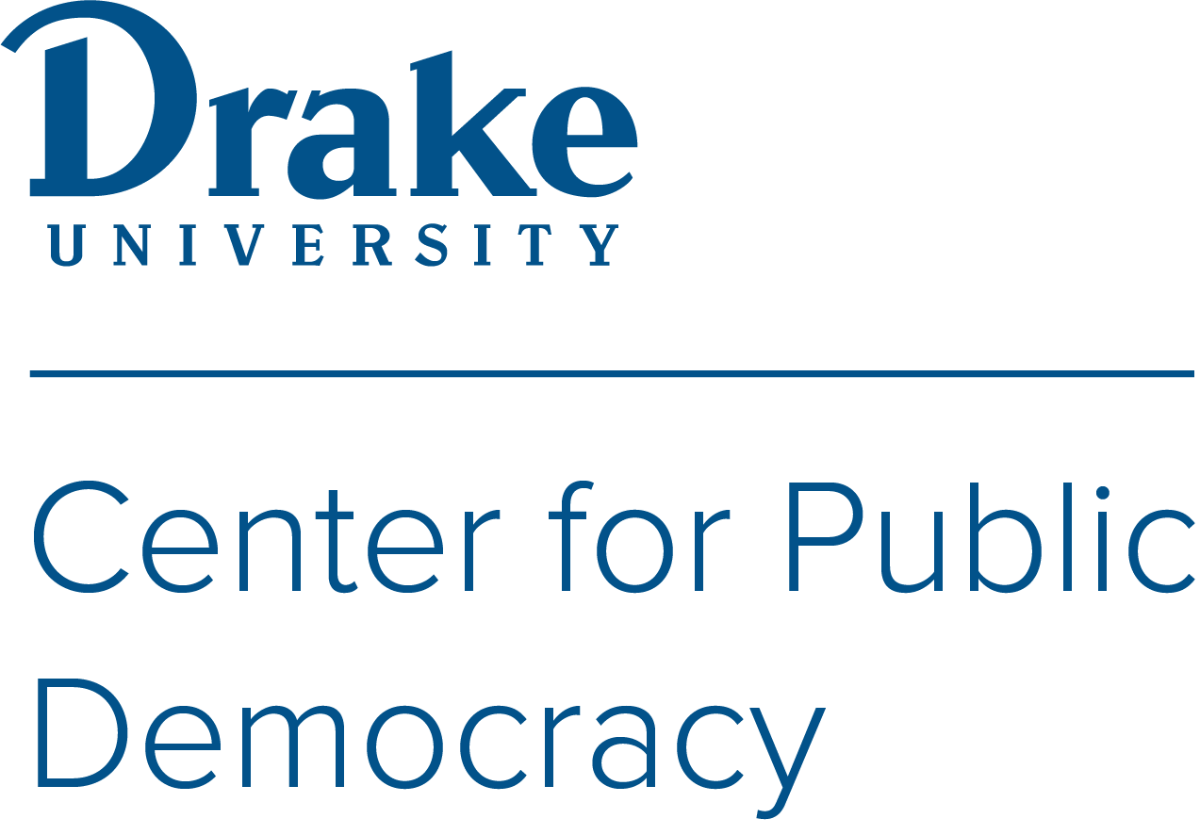


December 6, 2023

Slide 32
Through the National Civility Summit for Local Government we have come together to have candid discussions on the civility and leadership challenges impacting communities.
Our goal today is to provide local government officials, elected and appointed, with the tools and best practices needed to lead an engaged and participatory government.

Slide 34
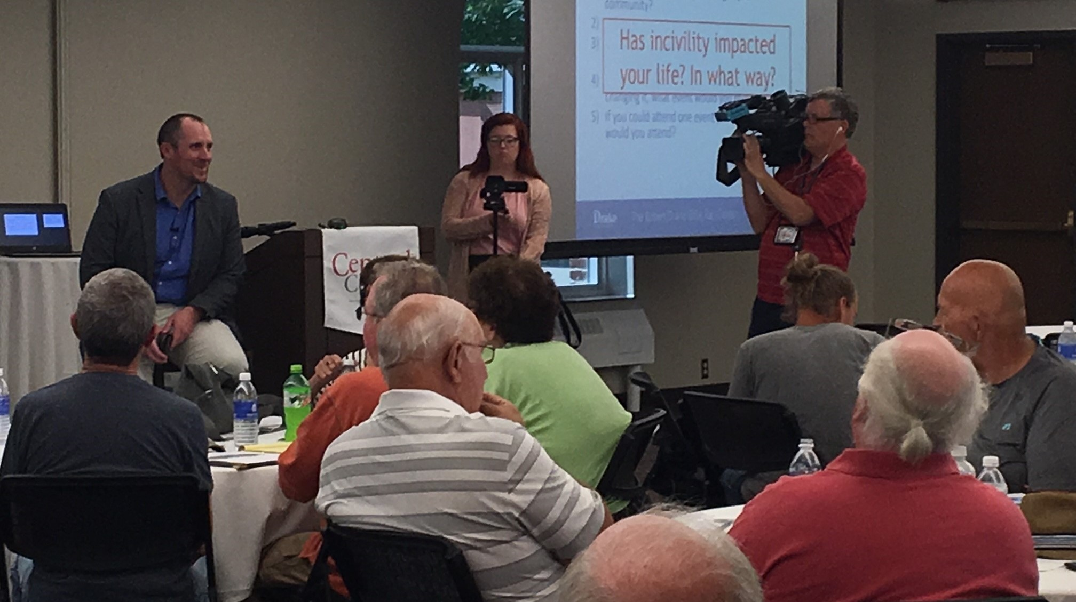
Community Conversations on Civility

